Slide 1

5

Slide 2
Echocardiography in
Critically ill Patients
Rasoul Azarfarin MD, FACC
Professor of Anesthesiology
Fellowship of Cardiac Anesthesia

Slide 3


Slide 4
Critically ill and hemodynamically unstable patients
(Extra-cardiac and Cardiac causes)
ARDS
Sepsis
Cardiac Tamponade
Acute Cor-pulmonale
Acute bleeding ant hypovolemia
Pulmonary thrombo-embolism (PTE)
Acute LV and RV failure (e.i. AMI)
Lethal Arrhythmias
Cardiac Arrest

Slide 5
Focused Assessed Transthoracic Echo (FATE) protocol

Slide 6
Diagnosis of “low cardiac output” state
Intensivist must differentiate Extra-Cardiac vs. Cardiac causes.
“Low cardiac output” stat not limited only to BP or CVP measurements.
Physician should evaluate the direct and indirect evidence of “Low-Cardiac Output” such as oliguria, cold and pale skin, …
The best way is a objective measurement of CO “Echocardiographic Assessment of Cardiac output”

Slide 7
Echocardiographic Assessment of Cardiac output:
CSA is calculated as π(D/2)² [or 0.785*D²}
SV = CSA x VTI
CO (cm³/min) = SV x HR

Slide 8
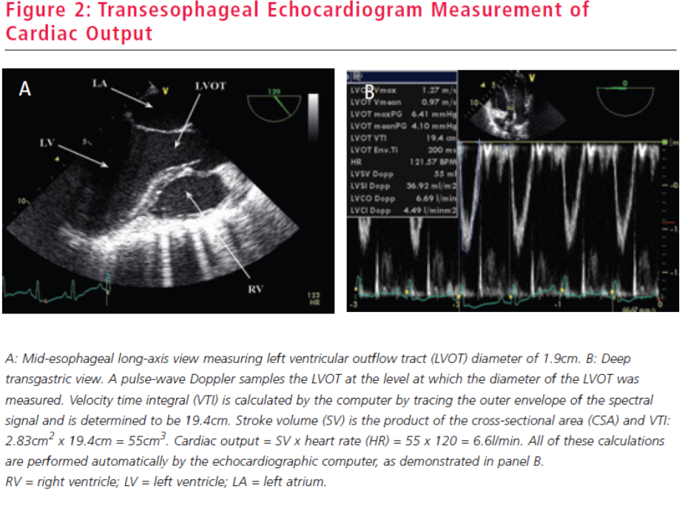

Slide 9
Superior Vena Cava Collapsibility Index
SVC collapsibility index = (Dmaxexp – Dminins)/Dmaxexp x 100
The SVC index can be calculated with TEE only by using either 2D or M-mode to measure the SVC diameter during PPV
An index of >36% has been shown to predict fluid responsiveness with high sensitivity and specificity (90 and 100%, respectively) and can be useful in predicting the need for fluid therapy in hemodynamically unstable patients.

Slide 10
Assessment of hypovolemia
- An index of >12% has been shown to discriminate between fluid responders and non-responders with high sensitivity and specificity (100 and 89%, respectively)

Slide 11
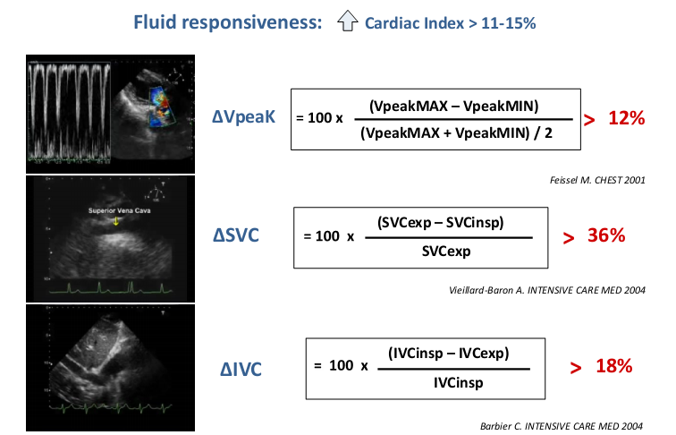

Slide 12
RATIONALE FOR ECHO USE IN ARDS
RV DYSFUNCTION: RECOGNITION & SUPPORT
VENTILATORY STRATEGY
DIFFERENTIAL DIAGNOSIS : ARDS vs. CARDIOGENIC PULMONARY EDEMA
INTRACARDIAC SHUNT DETECTION

Slide 13
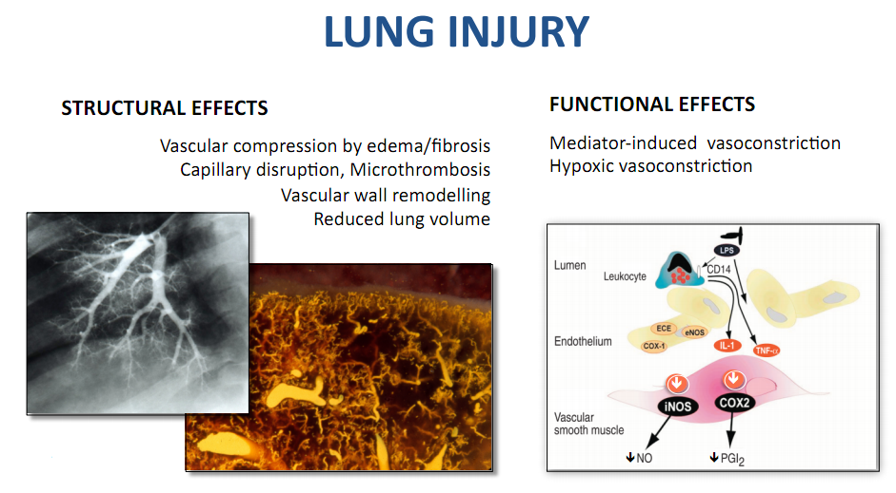
Pulmonary Hypertension in ARDS

Slide 14
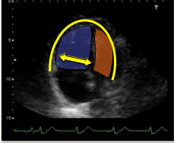
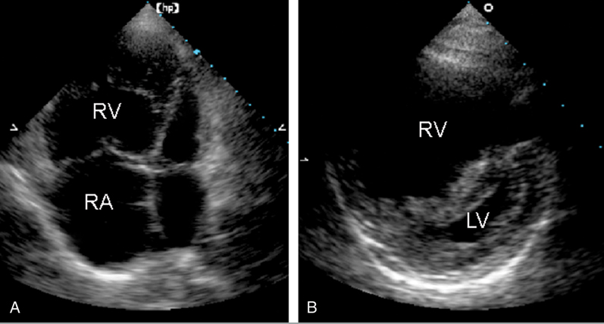
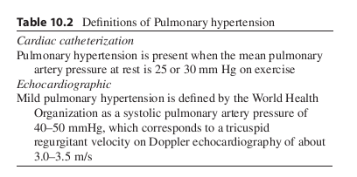
Acute cor pulmonale defined by the association of a septal dyskinesia with a right ventricle enlargement
(RVEDA/LVEDA > 0.6)

Slide 15
Patients with ARDS are at risk of acute Cor-pulmonale
Elevated PVR and
Raised intrathoracic pressure secondary to MV with high inflation pressure and high PEEP
Incidence of acute cor pulmonale in ARDS
still occurs in # 30% Despite Protective Lung Strategy
Dangers:
* RV dysfunction can reduce cardiac output
* Opening of a PFO causing right-to-left
intracardiac shunting & worsening hypoxemia

Slide 16
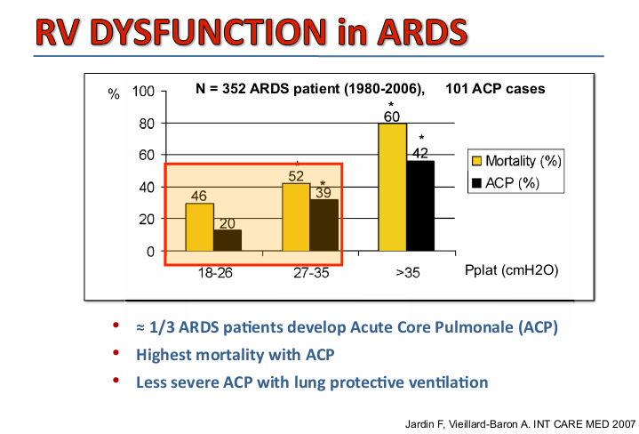

Slide 17
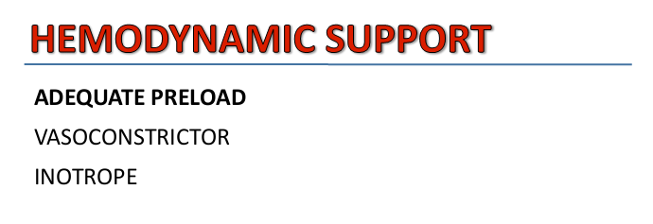
Treatment options in ARDS:
Adequate Preload
vasopressor support to augment RV perfusion pressure,
strategies to reduce PVR (correction of acidosis,
increasing FIo2, inhaled nitric oxide, etc.),
Reducing airway pressure
Prone positioning may be benficial
Ultrasonography of the chest cavity is also useful
to asses s the presence and size of pleural effusion

Slide 18
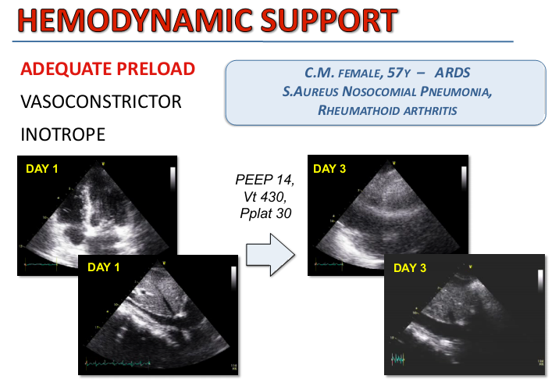

Slide 19
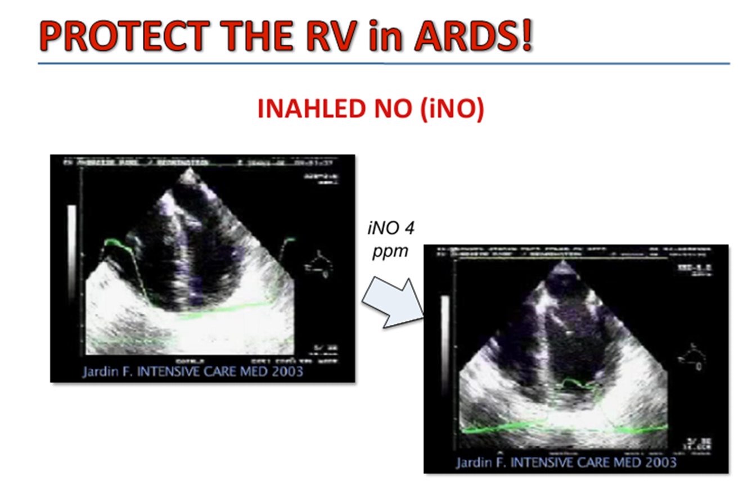

Slide 20
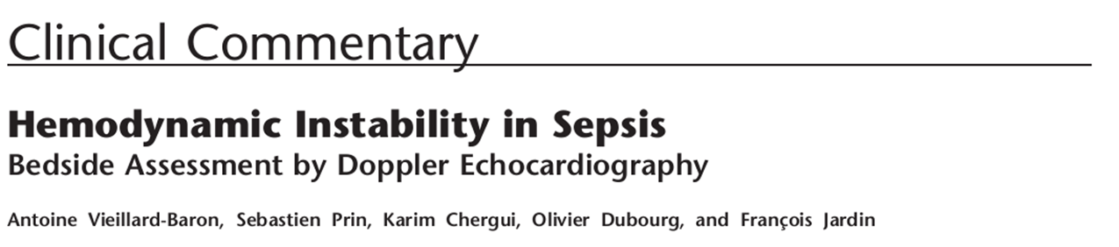
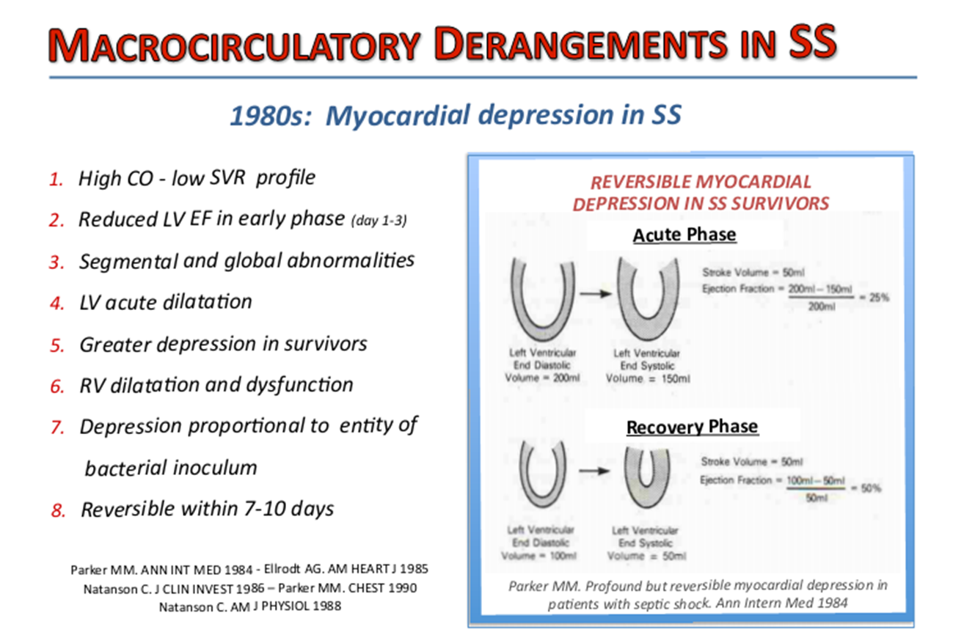
Septic Shock

Slide 21

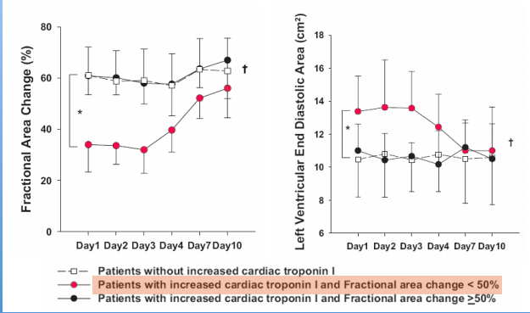
Whether cardiac ventricles can acutely dilate during septic myocardial dysfunction?
45 patients were studied over the first 10 days of septic shock

Slide 22
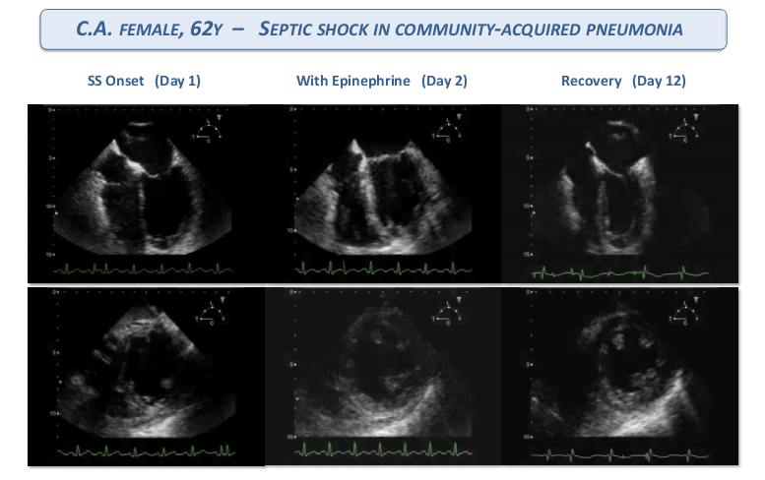

Slide 23
Practical Echocardiographic Evaluation
of Patients in Septic Shock
First Step: Evaluation of Cardiac Output (aortic VTI and heart rate)
Second Step: Evaluating Response to Fluids (expiratory variations in peak aortic flow and/or in superior vena cava)
Third Step: Evaluation of Cardiac Function (RV function-surfaces ratio and, eventually, septal bowing)

Slide 24
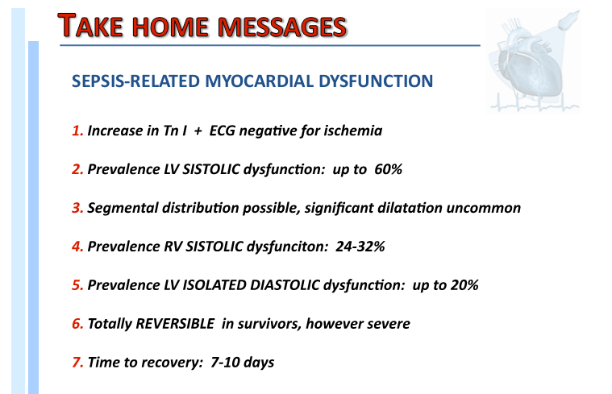
y
y

Slide 25
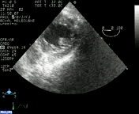
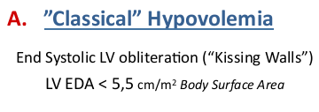
Hypovolemia and Preload Responsiveness

Slide 26
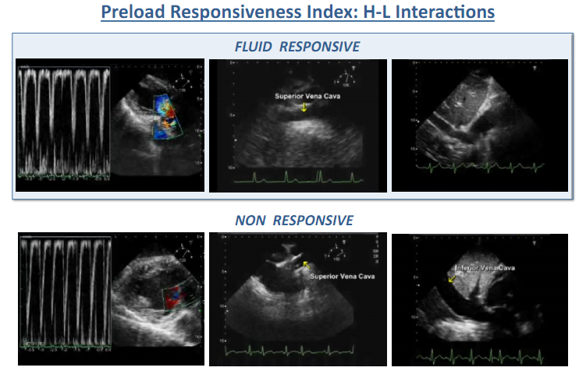

Slide 27
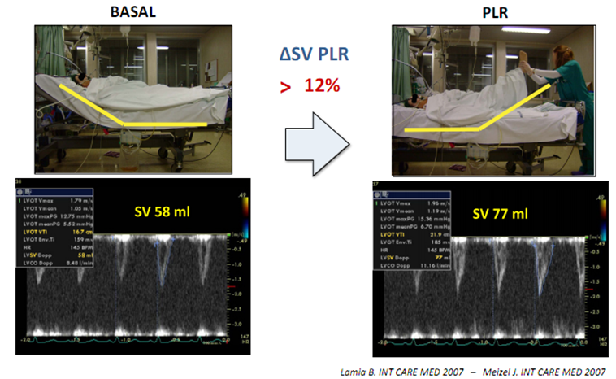
Preload Responsiveness
Performing TTE during a Simple test of “Passive Leg Rising” (PLR)
In spontaneously breathing patients with suspected hypovolemia, cardiac output or stroke volume measurement using echocardiography during passive leg raising can very accurately discriminate patients who will obtain a hemodynamic benefit from fluid challenge

Slide 28

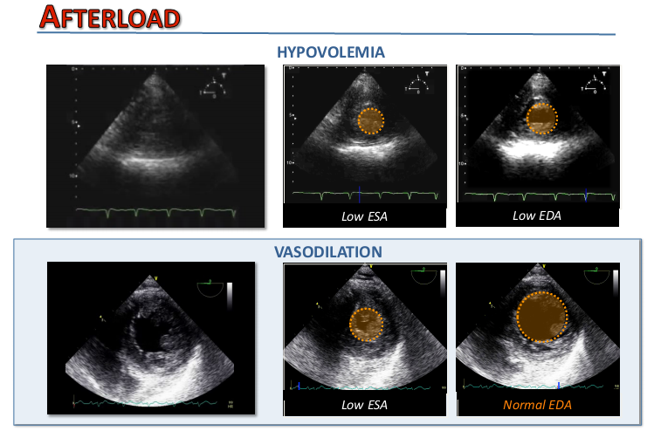

Slide 29
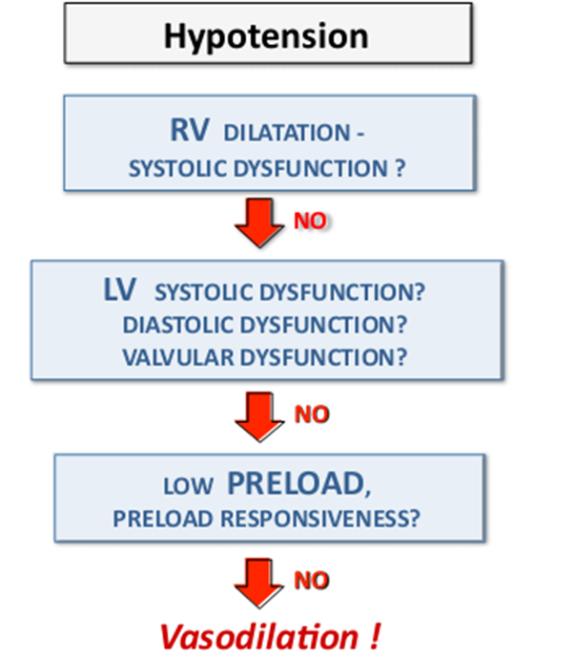
Practical approach to hypotensive patient in ICU

Slide 30
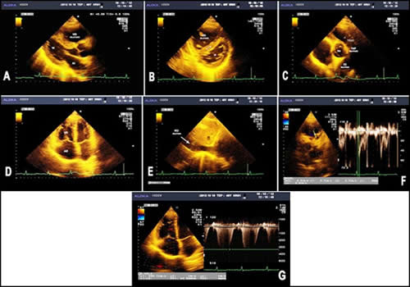
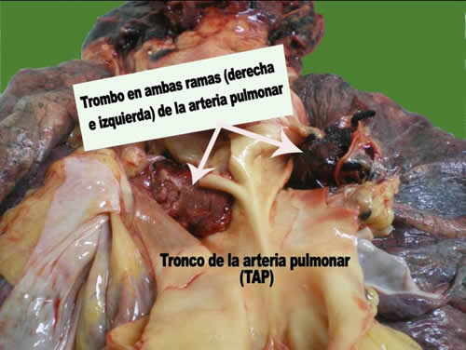
Pulmonary thrombo-embolism (PTE)
RV dilatation
RV hypokinesis
Paradoxical septal motion
IVC distension
(Peripheral views for DVT)

Slide 31
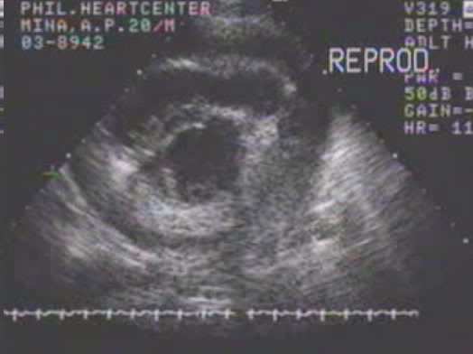
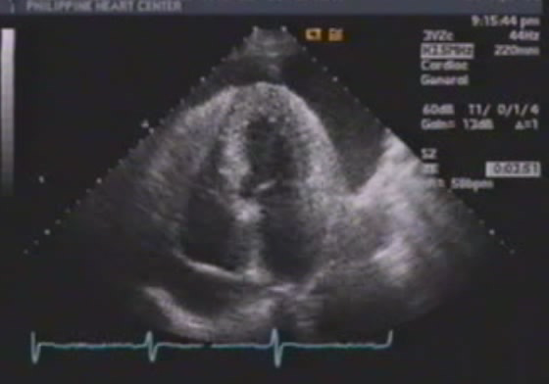
Massive pericardial effusion
Parasternal short-axis view at the mid-LV level showing the pericardial effusion
Apical 4-chamber view showing the pericardial effusion

Slide 33
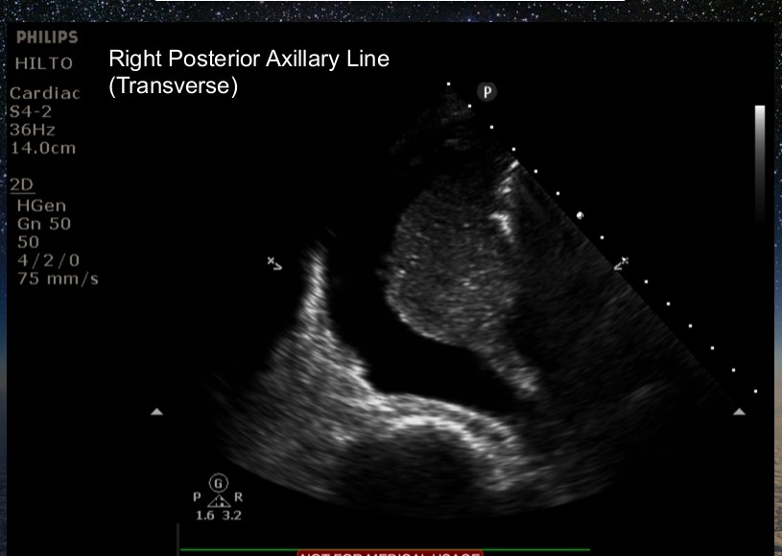
Lung Ultrasound in the Critically Ill

Slide 34
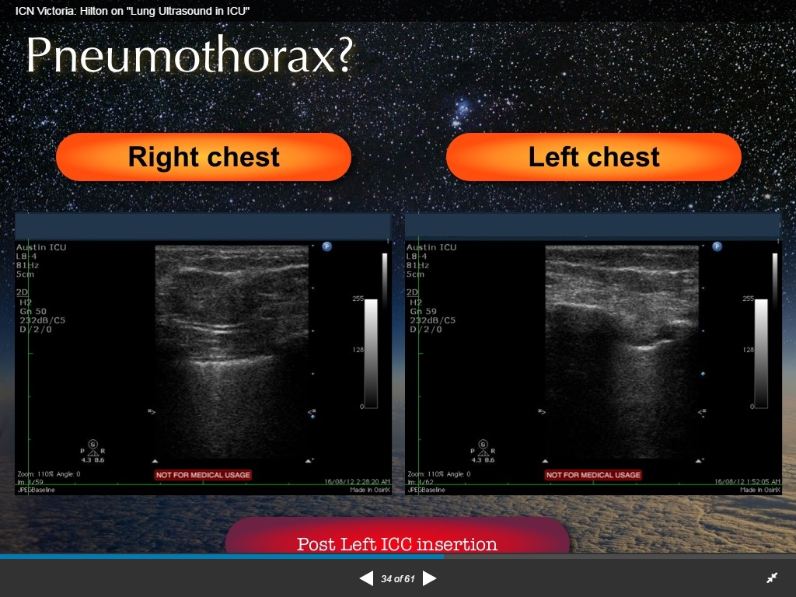

Slide 35
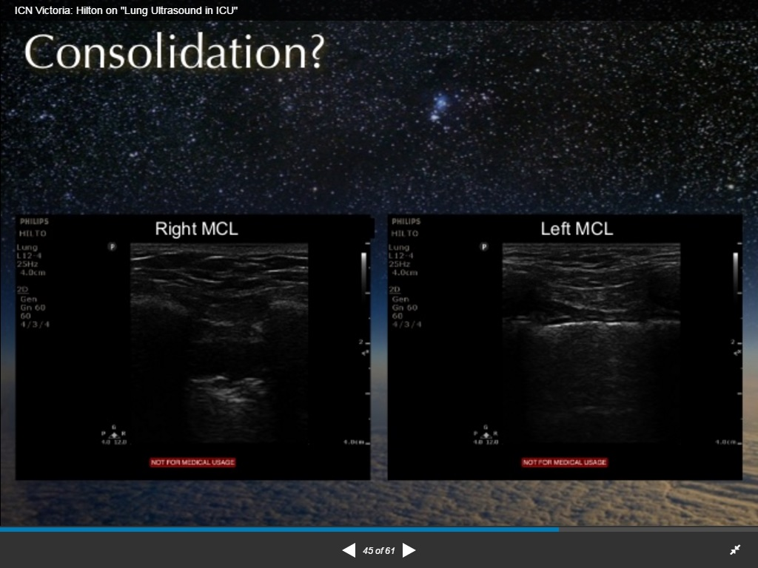

Slide 36
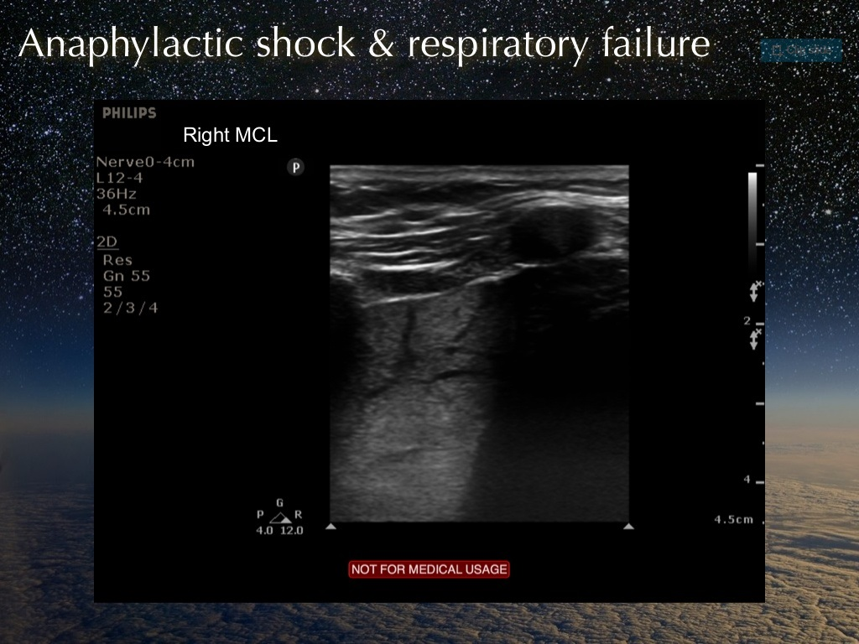

Slide 37
Cardiac Arrest (1)
Mainly detect organized cardiac activity
To find the treatable causes of Pulseless Electrical Activity:
  – Cardiac Tamponade
  – Hypovolaemia
  – +/-Massive PE
Many of the conditions underlying PEA (cardiac tamponade, hypovolemia, and pulmonary embolus) are associated with specific echocardiographic findings.

Slide 38
Cardiac Arrest (2)
Is there effective myocardial contractility?
  Asystole
  Myocardial “twitch”
  Hypokinesis
  Normal
Is there a pericardial effusion?
  Perform ECHO during “quick look” and in pulse checks
  Pericardiocentesis
Transvenous pacemaker placement
  Assessment of capture by transthoracic pacemaker
  Ettin D et al: Using ultrasound to determine external pacer capture

Slide 39
Echo during CPR
Utility of echo for in hospital cardiac arrests is for certain specialized arrests only (eg: peri-cardiac surgery,
blunt and penetrating chest trauma)
but not for your ‘routine ward arrest’

Slide 40
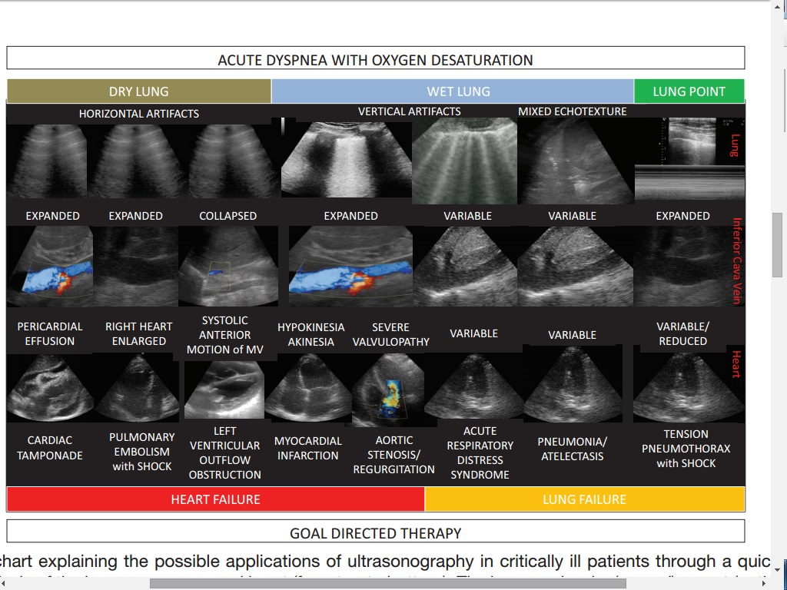

Slide 41
