Slide 1
Respiratory Anatomy and Physiology
Rasoul Azarfarin MD
Professor of Anesthesiology
Fellowship of Cardiac Anesthesia

Slide 2
Lecture Outline
Basics of the Respiratory System
  Functions & functional anatomy
Gas Laws
Ventilation
Diffusion & Solubility
Gas Exchange
  Lungs
  Tissues
Gas Transport in Blood
Regulation of Ventilation
  Gas levels, pH

Slide 3
Basics of the Respiratory System
General Functions
Exchange of gases
    Directionality depends on gradients!
  Atmosphere to blood
  Blood to tissues
Regulation of pH
  Dependent on rate of CO₂ release
Protection
Vocalization
Synthesis

Slide 4
Basics of the Respiratory System
Respiration
What is respiration?
  Respiration = the series of exchanges that leads to the uptake of oxygen by the cells, and the release of carbon dioxide to the lungs
    Step 1 = ventilation
      Inspiration & expiration
    Step 2 = exchange between alveoli (lungs) and pulmonary capillaries (blood)
      Referred to as External Respiration
    Step 3 = transport of gases in blood
    Step 4 = exchange between blood and cells
      Referred to as Internal Respiration
  Cellular respiration = use of oxygen in ATP synthesis

Slide 5
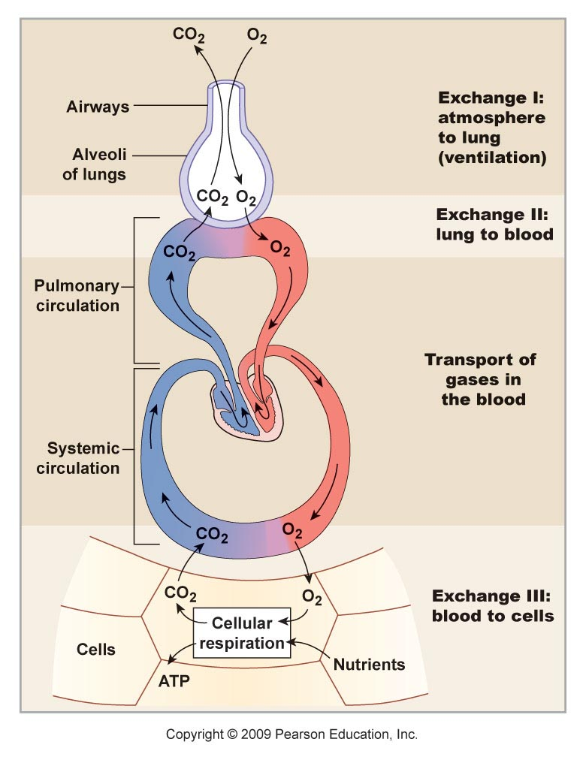
Schematic View of Respiration
External Respiration
Internal Respiration

Slide 6
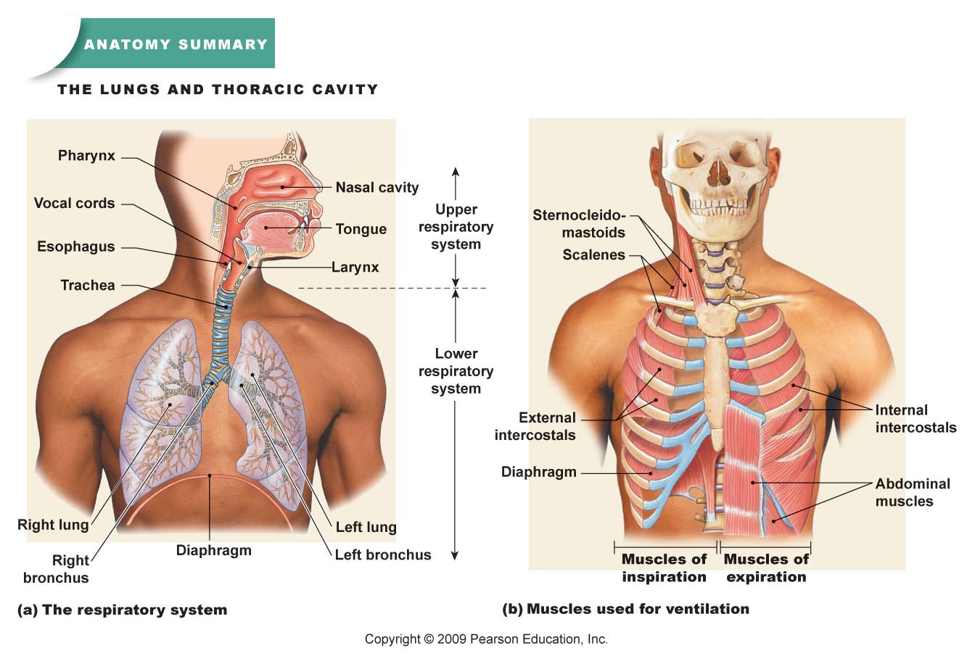
Basics of the Respiratory System
Functional Anatomy
What structural aspects must be considered in the process of respiration?
  The conduction portion
  The exchange portion
  The structures involved with
  ventilation
    Skeletal & musculature
    Pleural membranes
    Neural pathways
All divided into
  Upper respiratory tract
    Entrance to larynx
  Lower respiratory tract
    Larynx to alveoli (trachea
    to lungs)

Slide 7
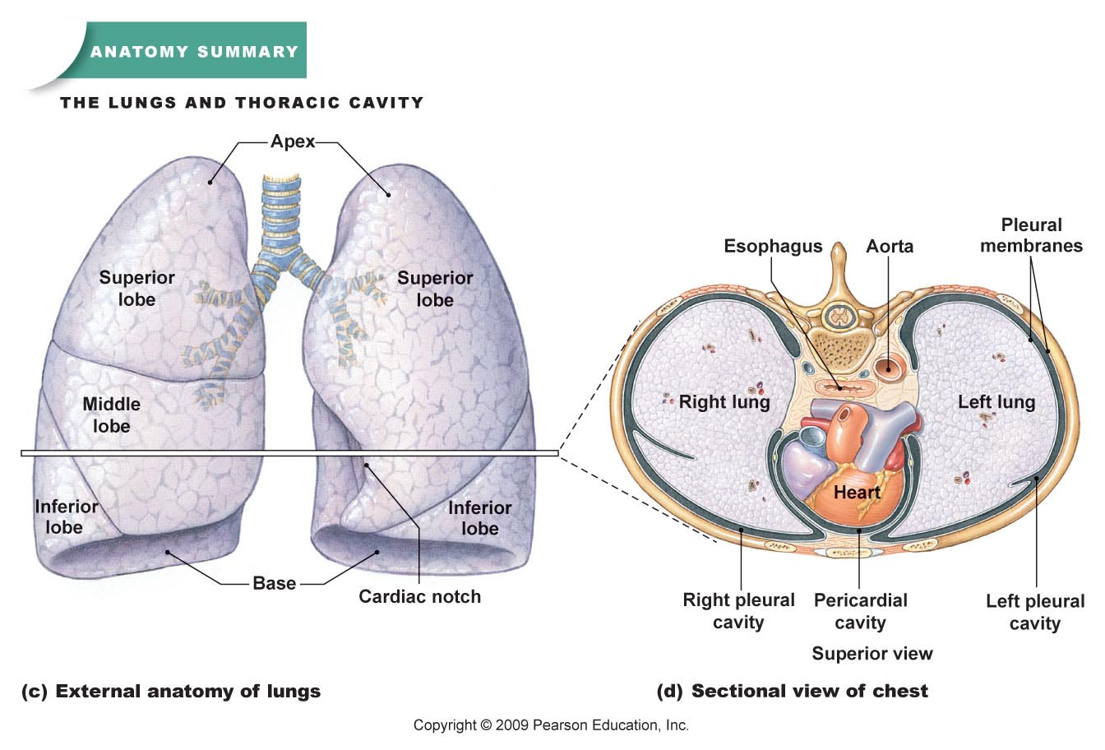
Basics of the Respiratory System
Functional Anatomy
Bones, Muscles & Membranes

Slide 8
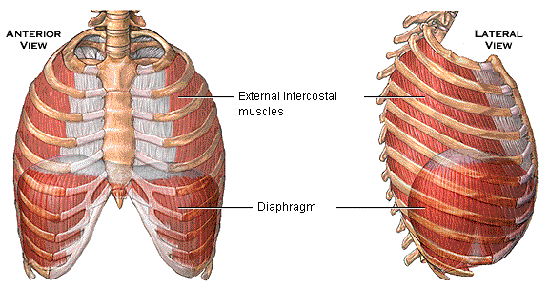
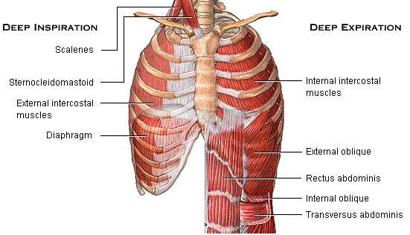

Slide 9
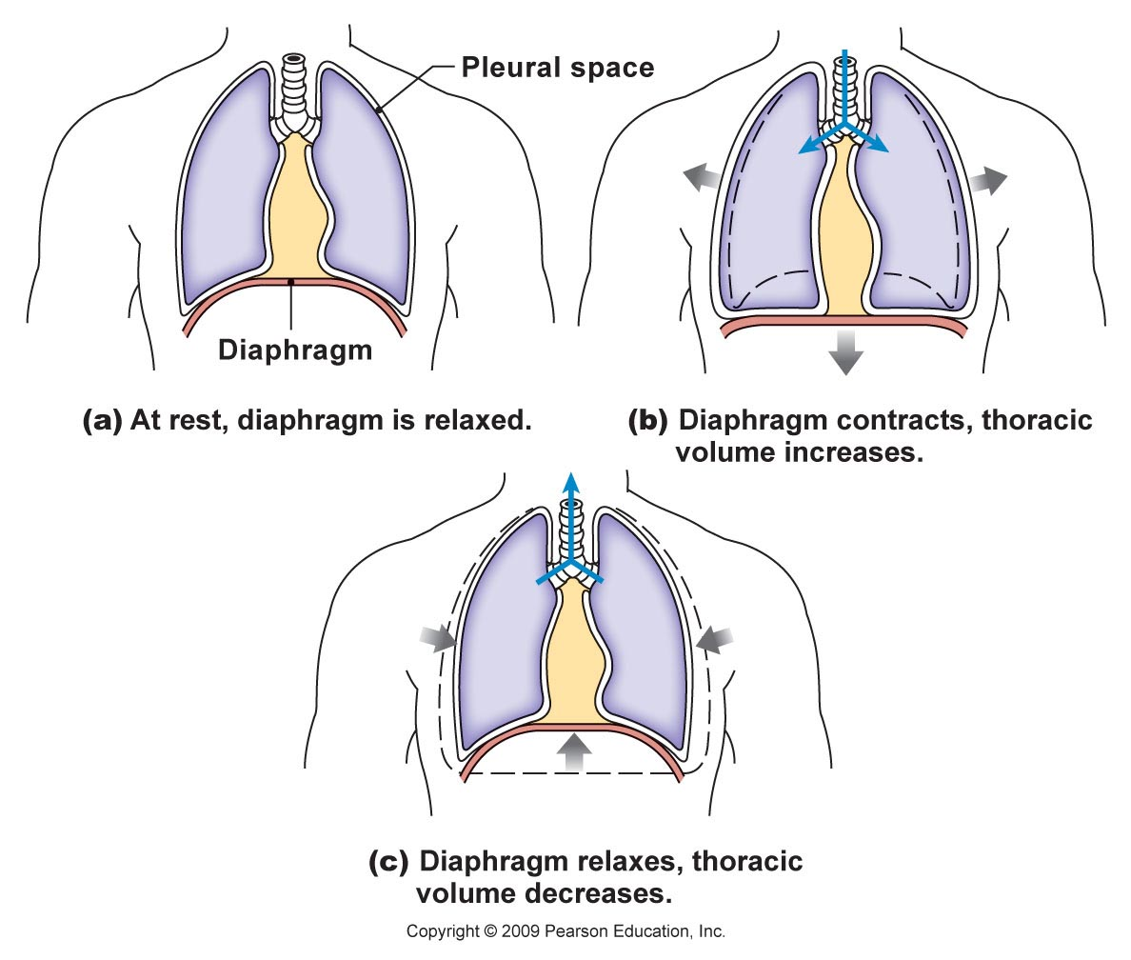
Basics of the Respiratory System
Functional Anatomy
Function of these Bones, Muscles & Membranes
  Create and transmit a pressure gradient
    Relying on
      the attachments of the
      muscles to the ribs
      (and overlying tissues)
      The attachment of the
      diaphragm to the base
      of the lungs and associated
      pleural membranes
      The cohesion of the parietal
      pleural membrane to the
      visceral pleural membrane
      Expansion & recoil of the lung
      and therefore alveoli with the
      movement of the overlying
      structures

Slide 10
Basics of the Respiratory System
Functional Anatomy
Pleural Membrane Detail
  Cohesion between parietal and visceral layers is due to serous fluid in the pleural cavity
    Fluid (30 ml of fluid) creates an attraction between the two sheets of membrane
    As the parietal membrane expands due to expansion of the thoracic cavity it “pulls” the visceral membrane with it
      And then pulls the underlying structures which expand as well
    Disruption of the integrity of the pleural membrane will result in a rapid equalization of pressure and loss of ventilation function = collapsed lung or pneumothorax

Slide 11
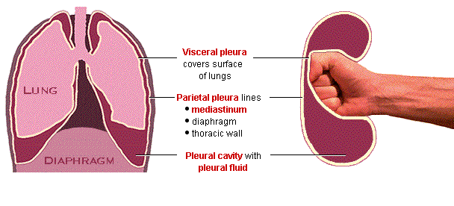

Slide 12
Basics of the Respiratory System
Functional Anatomy
The Respiratory Tree
  connecting the external environment to the exchange portion of the lungs
  similar to the vascular component
  larger airway = higher flow & velocity
    small cross-sectional area
  smaller airway = lower flow & velocity
    large cross-sectional area

Slide 13
Basics of the Respiratory System
Functional Anatomy
The Respiratory Tree
  Upper respiratory tract is for all intensive purposes a single large conductive tube
  The lower respiratory tract starts after the larynx and divides again and again…and again to eventually get to the smallest regions which form the exchange membranes
    Trachea
    Primary bronchi
    Secondary bronchi
    Tertiary bronchi
    Bronchioles
    Terminal bronchioles
    Respiratory bronchioles with
    start of alveoli outpouches
    Alveolar ducts with outpouchings
    of alveoli
conductive portion
exchange portion

Slide 14
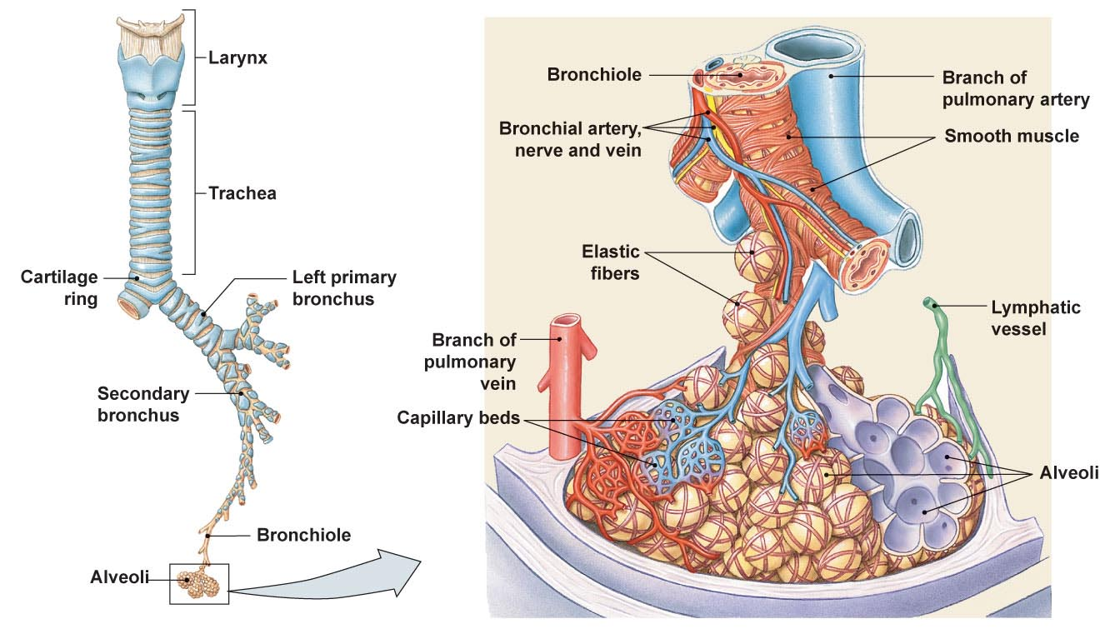
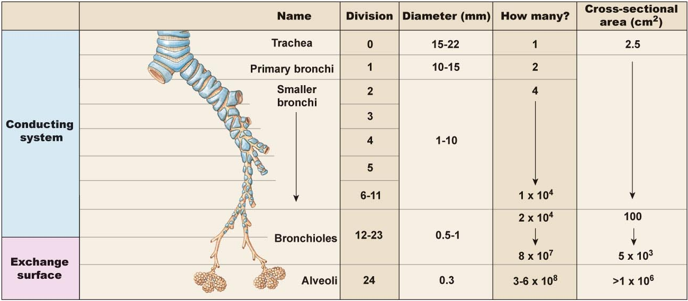

Slide 15
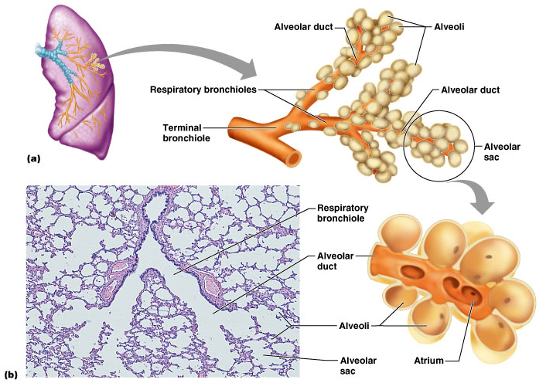

Slide 16
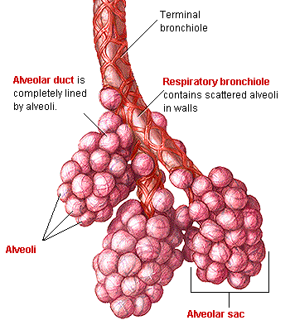
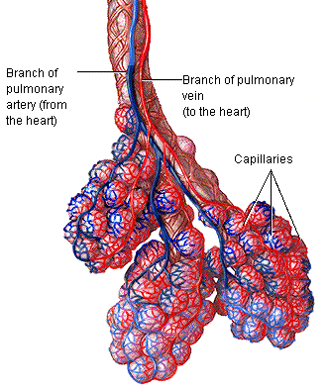

Slide 17
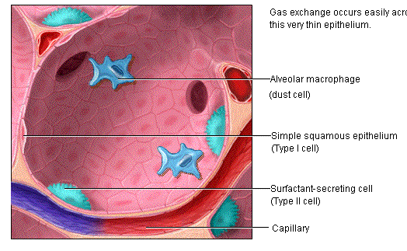

Slide 18
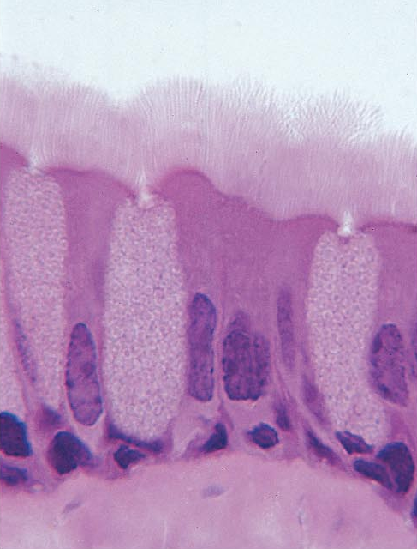
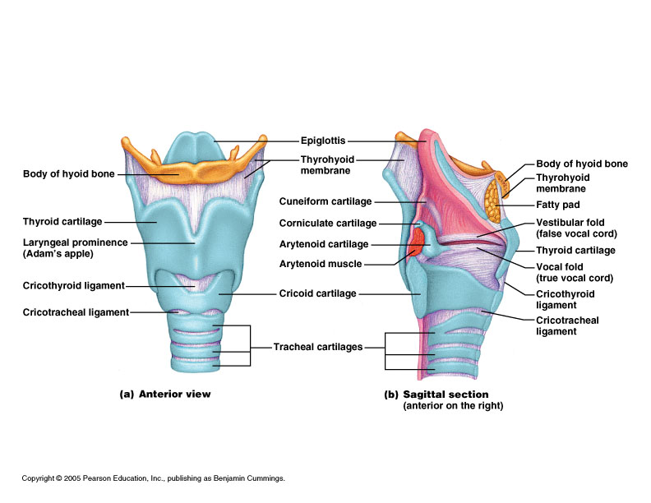
Basics of the Respiratory System
Functional Anatomy
What is the function of the upper respiratory tract?
  Warm
  Humidify
  Filter
  Vocalize
Raises incoming air to 37 Celsius
Forms mucociliary escalator
Raises incoming air to 100% humidity

Slide 19
Basics of the Respiratory System
Functional Anatomy
What is the function of the lower respiratory tract?
  Exchange of gases …. Due to
    Huge surface area = 1 x 10⁵ m² of type I alveolar cells (simple squamous epithelium)
    Associated network of pulmonary capillaries
      80-90% of the space between alveoli is filled with blood in pulmonary capillary networks
    Exchange distance is approx 1 um from alveoli to blood!
  Protection
    Free alveolar macrophages (dust cells)
    Surfactant produced by type II alveolar cells (septal cells)

Slide 20
Basics of the Respiratory System
Functional Anatomy
Characteristics of exchange membrane
  High volume of blood through huge capillary network results in
    Fast circulation through lungs
      Pulmonary circulation = 5L/min through lungs….
      Systemic circulation = 5L/min through entire body!
    Blood pressure is low…
      Means
        Filtration is not a main theme here, we do not want a net loss of fluid into the lungs as rapidly as the systemic tissues
        Any excess fluid is still returned via lymphatic system

Slide 21
Basics of the Respiratory System
Functional Anatomy
Sum-up of functional anatomy
  Ventilation?
  Exchange?
  Vocalization?
  Protection?

Slide 22
Respiratory Physiology
Gas Laws
Basic Atmospheric conditions
  Pressure is typically measured in mm Hg
  Atmospheric pressure is 760 mm Hg
  Atmospheric components
    Nitrogen = 78% of our atmosphere
    Oxygen = 21% of our atmosphere
    Carbon Dioxide = .033% of our atmosphere
    Water vapor, krypton, argon, …. Make up the rest
A few laws to remember
  Dalton’s law
  Fick’s Laws of Diffusion
  Boyle’s Law
  Ideal Gas Law

Slide 23
Respiratory Physiology
Gas Laws
Dalton’s Law
  Law of Partial Pressures
    “each gas in a mixture of gases will exert a pressure independent of other gases present”
      Or
    The total pressure of a mixture of gases is equal to the sum of the individual gas pressures.
  What does this mean in practical application?
    If we know the total atmospheric pressure (760 mm Hg) and the relative abundances of gases (% of gases)
      We can calculate individual gas effects!
      P_{atm} x % of gas in atmosphere = Partial pressure of any atmospheric gas
        P_{O2} = 760mmHg x 21% (.21) = 160 mm Hg
    Now that we know the partial pressures we know the gradients that will drive diffusion!

Slide 24
Respiratory Physiology
Gas Laws
Fick’s Laws of Diffusion
  Things that affect rates of diffusion
    Distance to diffuse
    Gradient sizes
    Diffusing molecule sizes
    Temperature
  What is constant & therefore out of our realm of concern?
    So it all comes down to partial pressure gradients of gases… determined by Dalton’s Law!





Slide 25
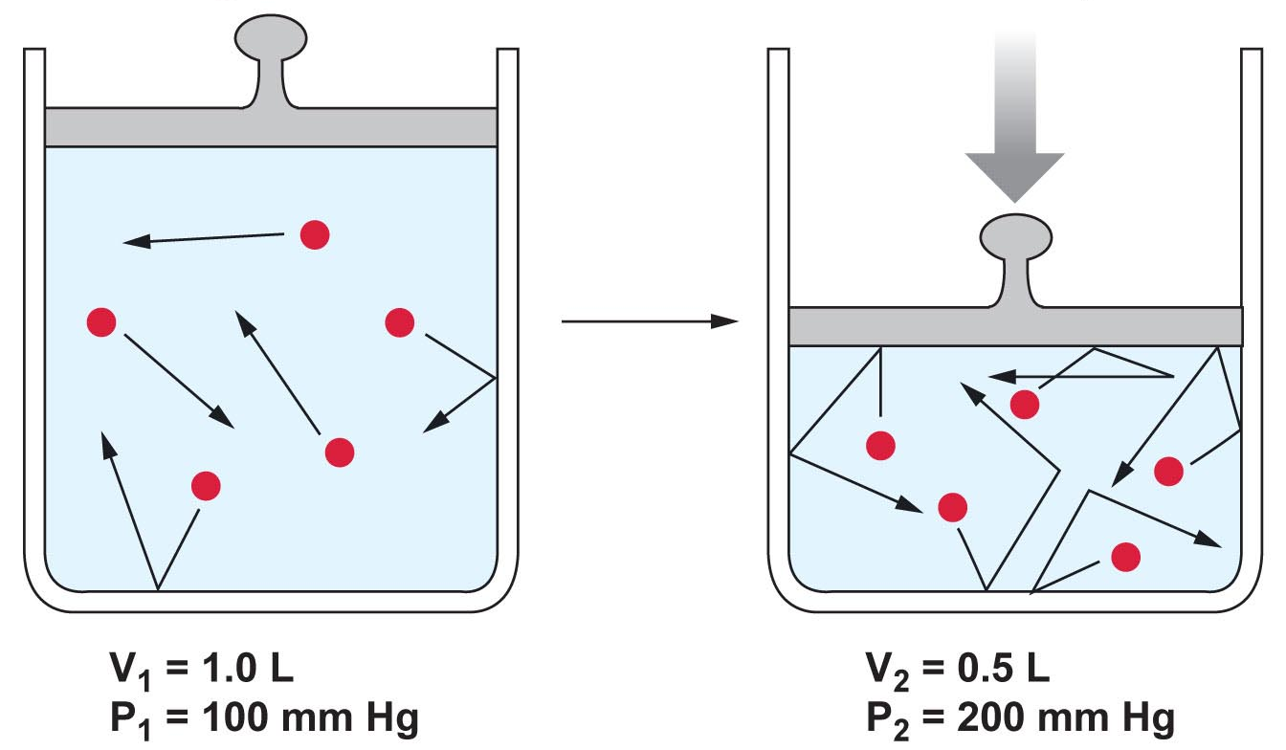
Respiratory Physiology
Gas Laws
Boyle’s Law
  Describes the relationship between pressure and volume
    “the pressure and volume of a gas in a system are inversely related”
    P₁V₁ = P₂V₂

Slide 26
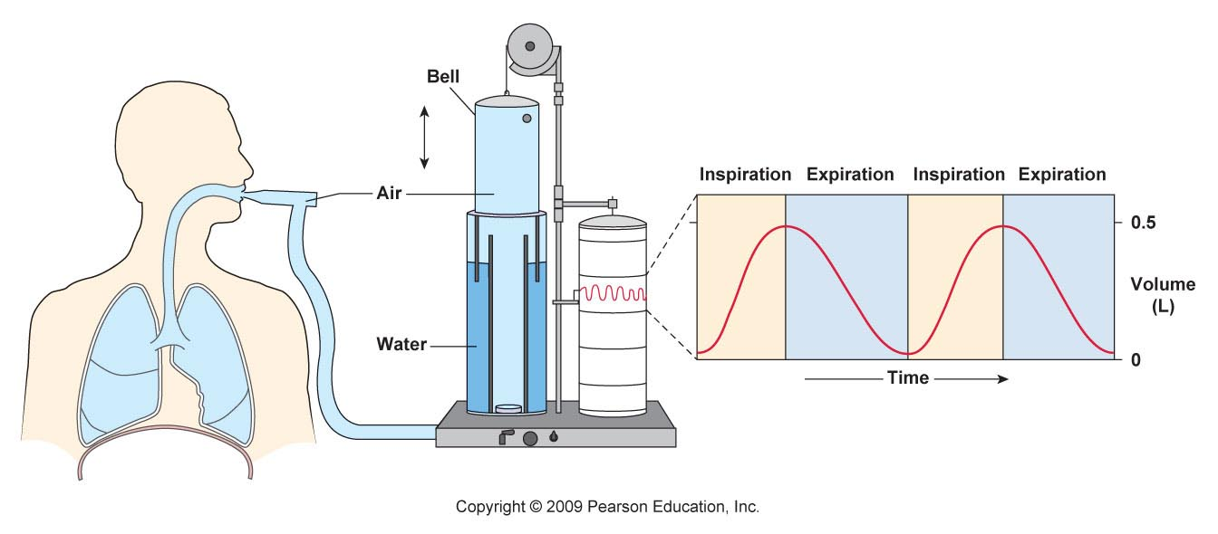
Respiratory Physiology
Gas Laws
How does Boyle’s Law work in us?
  As the thoracic cavity (container) expands the volume must up and pressure goes down
    If it goes below 760 mm Hg what happens?
  As the thoracic cavity shrinks the volume must go down and pressure goes up
    If it goes above 760 mm Hg what happens

Slide 27
Respiratory Physiology
Gas Laws
Ideal Gas law
  The pressure and volume of a container of gas is directly related to the temperature of the gas and the number of molecules in the container
  PV = nRT
    n = moles of gas
    T = absolute temp
    R = universal gas constant @ 8.3145 J/K·mol
  Do we care?

Slide 28
Respiratory Physiology
Gas Laws
Can’t forget about poor Charles and his law or Henry and his law
  Aptly named … Charles’s Law & Henry’s Law
As the temp goes up in a volume of gas the volume rises proportionately
V∝T
At a constant temperature, the amount of a given gas dissolved in a given type and volume of liquid is directly proportional to the partial pressure of that gas in equilibrium with that liquid.
OR
the solubility of a gas in a liquid at a particular temperature is proportional to the pressure of that gas above the liquid.
*also has a constant which is different for each gas

Slide 29
Ventilation
Terminology
  Inspiration = the movement of air into the respiratory tracts (upper & lower)
  Expiration = movement of air out of the respiratory tracts
  Respiratory cycle is one inspiration followed by an expiration
Cause of Inspiration?
  Biological answer
    Contraction of the inspiratory muscles causes an increase in the thoracic cavity size, thus allowing air to enter the respiratory tract
  Physics answer
    As the volume in the thoracic cavity increases (due to inspiratory muscle action) the pressure within the respiratory tract drops below atmospheric pressure, creating a pressure gradient which causes molecular movement to favor moving into the respiratory tract
  Cause of Expiration?

Slide 30
Ventilation
Besides the diaphragm (only creates about 60-75% of the volume change) what are the muscles of inspiration & expiration?

Slide 31
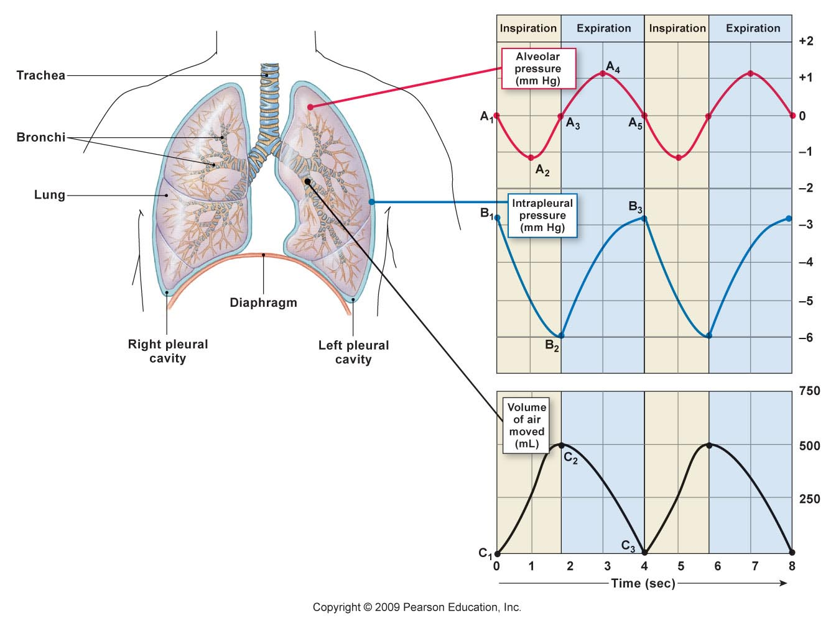
Ventilation
What is the relationship between alveolar pressure and intrapleural pressure and the volume of air moved?

Slide 32
Ventilation
What are the different respiratory patterns?
  Quiet breathing (relaxed)
  Forced inspirations & expirations
Respiratory volumes follow these respiratory patterns…

Slide 33
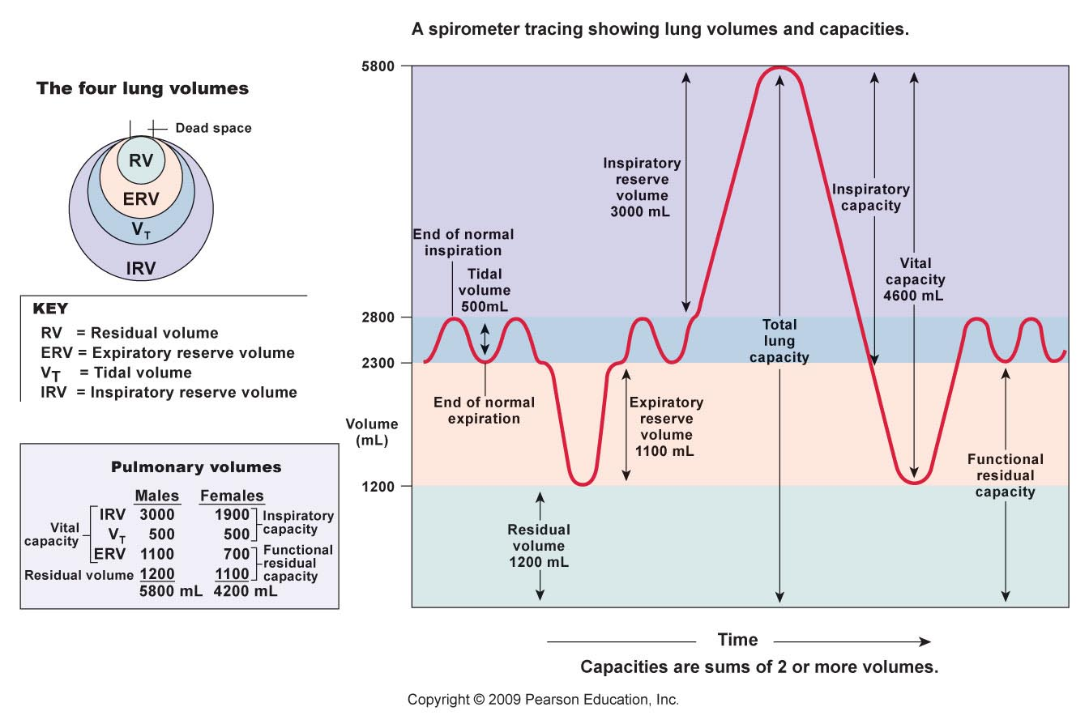
Ventilation

Slide 34
Ventilation
Inspiration
  Occurs as alveolar pressure drops below atmospheric pressure
    For convenience atmospheric pressure = 0 mm Hg
      A (-) value then indicates pressure below atmospheric P
      A (+) value indicates pressure above atmospheric P
    At the start of inspiration (time = 0),
      atmospheric pressure = alveolar pressure
        No net movement of gases!
    At time 0 to 2 seconds
      Expansion of thoracic cage and corresponding pleural membranes and lung tissue causes alveolar pressure to drop to -1 mm Hg
      Air enters the lungs down the partial pressure gradient

Slide 35
Ventilation
Expiration
  Occurs as alveolar pressure elevates above atmospheric pressure due to a shrinking thoracic cage
    At time 2-4 seconds
      Inspiratory muscles relax, elastic tissue of corresponding structures initiates a recoil back to resting state
      This decreases volume and correspondingly increases alveolar pressure to 1 mm Hg
        This is above atmospheric pressure, causing…?
    At time 4 seconds
      Atmospheric pressure once again equals alveolar pressure and there is no net movement

Slide 36
Ventilation
Both inspiration and expiration can be modified
  Forced or active inspiration
  Forced or active expiration
  The larger and quicker the expansion of the thoracic cavity, the larger the gradient and
    The faster air moves down its pressure gradient

Slide 37
Ventilation
Things to consider
  surfactant effect
  airway diameter
  Minute volume respiration (ventilation rate times tidal volume) & anatomical dead space
    Leading to a more accurate idea of alveolar ventilation rates
  Changes in ventilation patterns

Slide 38
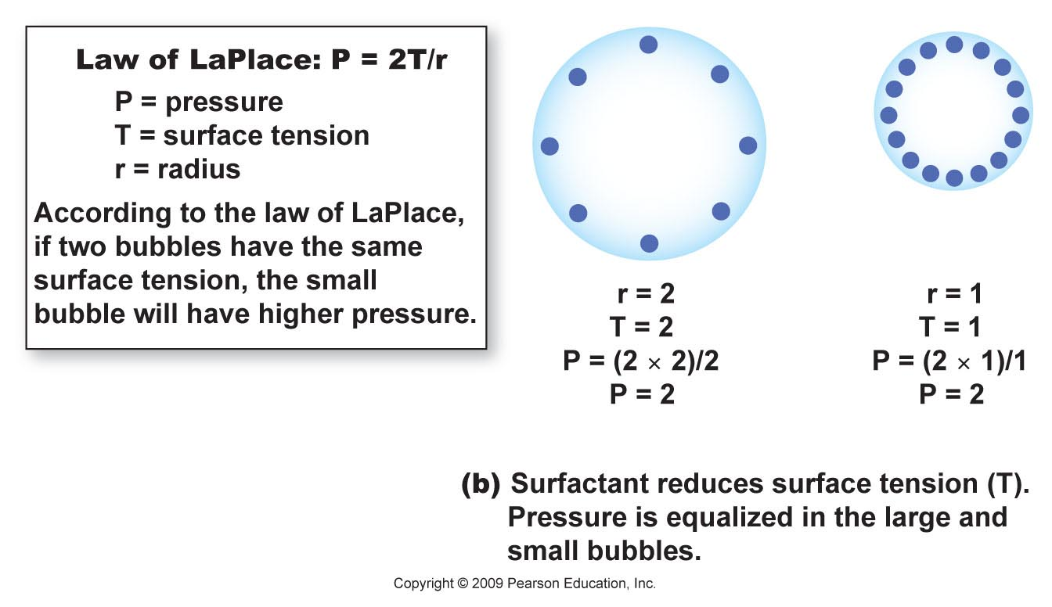
Ventilation
Surfactant is produced by the septal cells
  Disrupts the surface tension & cohesion of water molecules
  Impact?
    prevents alveoli from sticking together during expiration

Slide 39
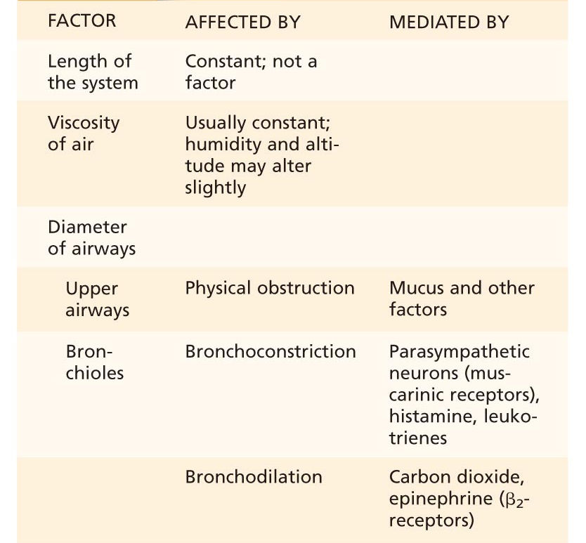
Ventilation
Airway diameter & other factors that affect airway resistance?

Slide 40
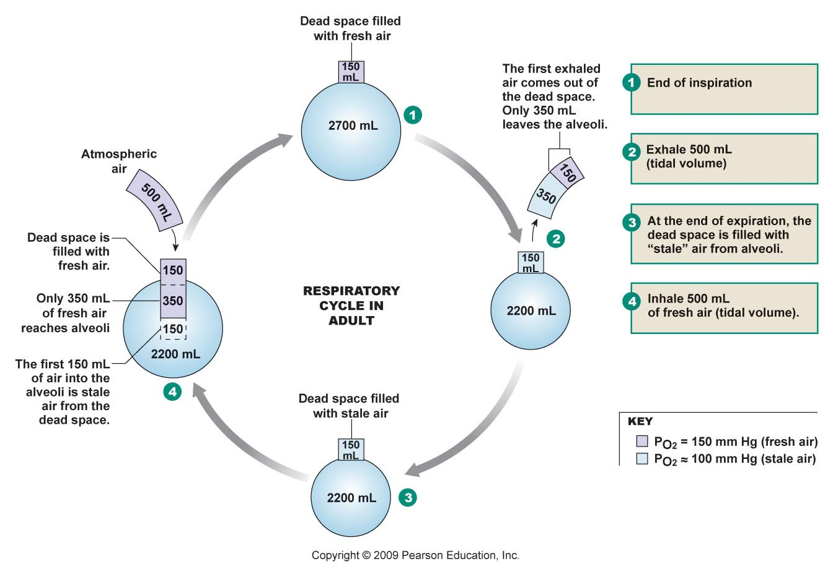
Ventilation
The relationship between minute volume (total pulmonary ventilation) and alveolar ventilation & the subsequent “mixing” of air

Slide 41
Gas Exchange
Partial Pressure
  Each gas in atmosphere contributes to the entire atmospheric pressure, denoted as P
Gases in liquid
  Gas enters liquid and dissolves in proportion to its partial pressure
O2 and CO2 Exchange by DIFFUSION
  PO2 is 105 mmHg in alveoli and 40 in alveolar capillaries
  PCO2 is 45 in alveolar capillaries and 40 in alveoli

Slide 42
Partial Pressures
Oxygen is 21% of atmosphere
760 mmHg x .21 = 160 mmHg PO2
This mixes with “old” air already in alveolus to arrive at PO2 of 105 mmHg

Slide 43
Partial Pressures
Carbon dioxide is .04% of atmosphere
760 mmHg x .0004 = .3 mm Hg PCO2
This mixes with high CO2 levels from residual volume in the alveoli to arrive at PCO2 of 40 mmHg

Slide 44
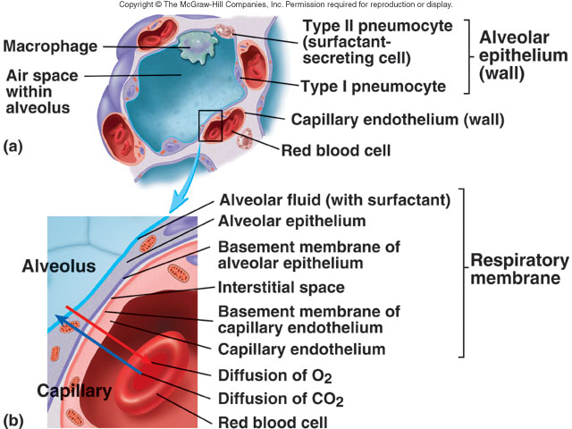

Slide 45
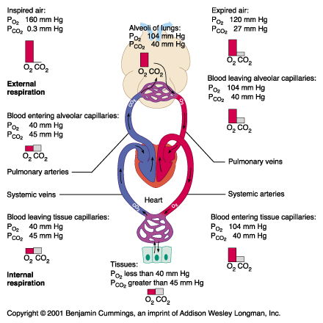

Slide 46
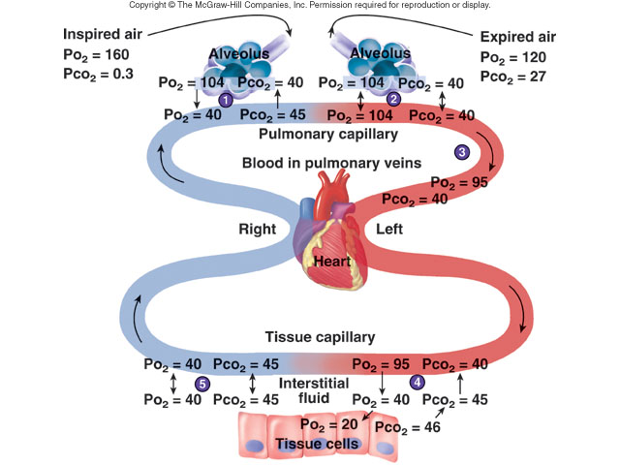

Slide 47
Gas Transport
O2 transport in blood
Hemoglobin – O2 binds to the heme group on hemoglobin, with 4 oxygens/Hb
PO2
PO2 is the most important factor determining whether O2 and Hb combine or dissociate
O2-Hb Dissociation curve

Slide 48
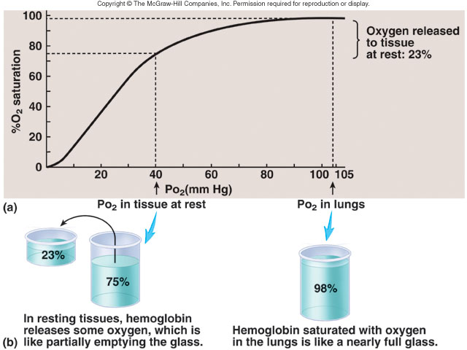

Slide 49
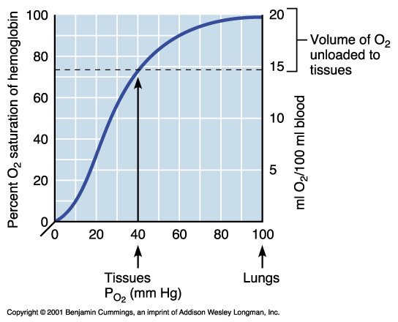

Slide 50
Gas Transport
pH
CO2
Temperature
DPG

Slide 51
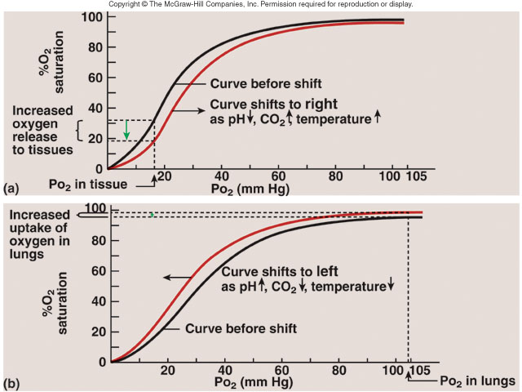

Slide 52
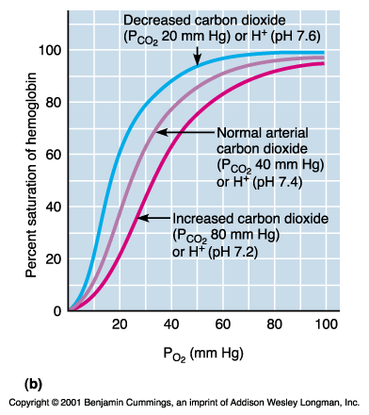

Slide 53
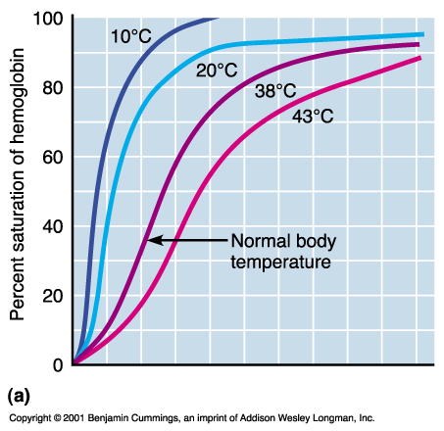

Slide 54
Oxygen

Slide 55
Carbon Dioxide

Slide 56
Gas Transport
CO2 transport
7% in plasma
23% in carbamino compounds (bound to globin part of Hb)
70% as Bicarbonate

Slide 57
Carbon Dioxide
CO2 + H2O <->H2CO3<->H+ + HCO3-
Enzyme is Carbonic Anhydrase
Chloride shift to compensate for bicarbonate moving in and out of RBC

Slide 58
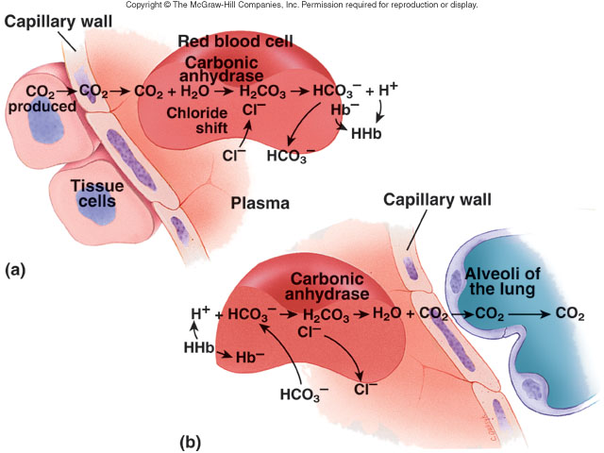

Slide 59
Blood pH
Arterial blood (Oxygenated)
  7.41
Venous blood (Deoxygenated)
  7.37 (slightly more acidic but buffered by blood buffers)
  In exercise venous blood can drop to 6.9

Slide 60
Respiratory exchange ratio
Ratio of CO2 output to O2 uptake
  R= 4/5=.8
What happens to Oxygen in the cells
  converted to carbon dioxide (80%)
  converted to water (20%)
    As fatty acid utilization for E increases the percentage of metabolic water generated from O2 increases to a maximum of 30%.
    If only CHO are used for energy no metabolic water is generated from O2, all O2 is converted to CO2

Slide 63
Respiratory Centers
Located in brain stem
  Dorsal & Ventral Medullary group
  Pneumotaxic & Apneustic centers
Affect rate and depth of ventilation
Influenced by:
  higher brain centers
  peripheral mechanoreceptors
  peripheral & central chemoreceptors

Slide 64
Controls of Respiration
Medullary Rhythmicity Area
  Medullary Inspiratory Neurons are main control of breathing
    Pons neurons influence inspiration, with Pneumotaxic area limiting inspiration and Apneustic area prolonging inspiration.
    Lung stretch receptors limit inspiration from being too deep

Slide 65
Controls
Medullary Rhythmicity Area
  Medullary Expiratory Neurons
    Only active with exercise and forced expiration

Slide 66
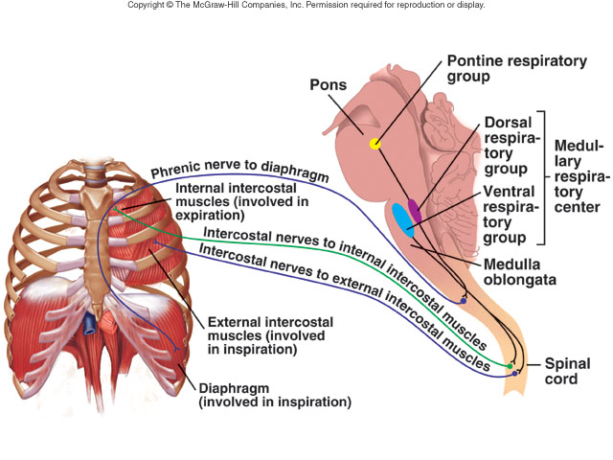

Slide 67
Autonomic control of airways
Efferent Neural control
  SNS-beta receptors causing dilatation
    direct effect weak due to sparse innervation
    indirect effect predominates via circulating epinephrine
  Parasympathetic-muscarinic receptors causing constriction
  NANC nerves (non-adrenergic, non-cholinergic)
    Inhibitory release VIP and NO ⇒ bronchodilitation
    Stimulatory ⇒ bronchoconstriction, mucous secretion, vascular hyperpermeability, cough, vasodilation “neurogenic inflammation”

Slide 68
Autonomic control of airways
Afferent nerves
  Slow adapting receptors
    Associated with smooth muscle of proximal airways
    Stretch receptors
      Involved in reflex control of breathing and cough reflex
  Rapidly adapting receptors
    Sensitive to mechanical + , protons, low Cl- solutions, histamine, cigarette smoke, ozone, serotonin, PGF _{2α}
      Some responses may be secondary to mechanical distortion produced by bronchoconstriction

Slide 69
Autonomic control of airways
  C-fibers (high density)
    Contain neuropeptides
      Substance P, neurokinin A, calcitonin gene-related peptide
    Selectively + by capsaicin
    Also activated by bradykinin, protons, hyperosmole solutions and cigarette smoke

Slide 70
Patterns of Breathing
Eupnea
  normal breathing (12-17 B/min, 500-600 ml/B)
Hyperpnea
  ⇑ pulmonary ventilation matching ⇑ metabolic demand
Hyperventilation (⇓ CO₂)
  ⇑ pulmonary ventilation > metabolic demand
Hypoventilation (⇑ CO₂)
  ⇓ pulmonary ventilation < metabolic demand

Slide 71
Patterns of breathing (cont.)
Tachypnea
  ⇑ frequency of respiratory rate
Apnea
  Absense of breathing. e.g. Sleep apnea
Dyspnea
  Difficult or labored breathing
Orthopnea
  Dyspnea when recumbent, relieved when upright. e.g. congestive heart failure, asthma, lung failure

Slide 72
Ventilation-Perfusion ratios
Normally alveolar ventilation is matched to pulmonary capillary perfusion at a rate of 4L/min of air to 5L/min of blood
4/5 = .8 is the normal V/P ratio
If the ratio decreases, it is usually due to a problem with decreased ventilation
If the ratio increases, it is usually due to a problem with decreased perfusion of lungs

Slide 73
Ventilation-Perfusion ratios
A decreased V/P ratio as ventilation goes to zero
Not enough ventilation for the amount of pulmonary blood flow (perfusion)
  Alveolar PO₂ will decrease toward 40 mmHg
  Alveolar PCO₂ will increase toward 45 mmHg
  Results in an increase in “physiologic shunt blood”- blood that is not oxygenated as it passes the lung

Slide 74
Ventilation-Perfusion ratios
An increased V/P ratio due to a decreased perfusion of the lungs from the RV
Not enough pulmonary blood flow (perfusion) for the amount of ventilation
  Alveolar PO2 will increase toward 149 mmHg
  Alveolar PCO2 will decrease toward O mmHg
  Results in an increase of physiologic dead space- area in the lungs where oxygenation is not taking place
    includes non functional alveoli

Slide 76
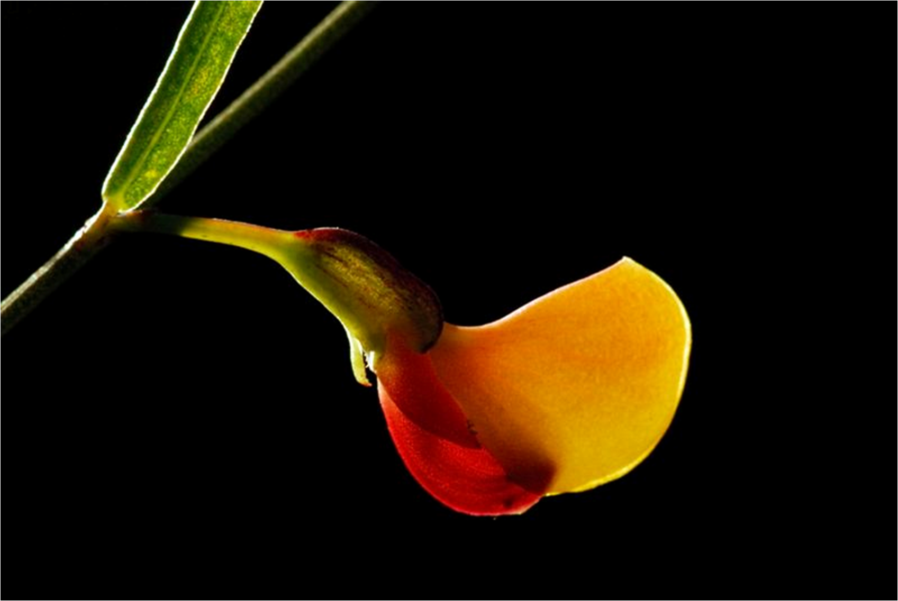
Controls of rate and depth of respiration
Thank You
Arterial PO2
  When PO2 is VERY low, ventilation increases
Arterial PCO2
  The most important regulator of ventilation, small increases in PCO2, greatly increases ventilation
Arterial pH
  As hydrogen ions increase, alveolar ventilation increases, but hydrogen ions cannot diffuse into CSF as well as CO2

