Slide 1


Slide 2
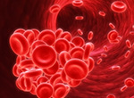
Goal Directed Hemostatic Therapy Based on ROTEM in Cardiac Surgery
Rasoul Azarfarin MD, FACC
Professor of Anesthesiology
Fellowship of Cardiac Anesthesia
Rajaie Cardiovascular Medical & Research Center

Slide 3
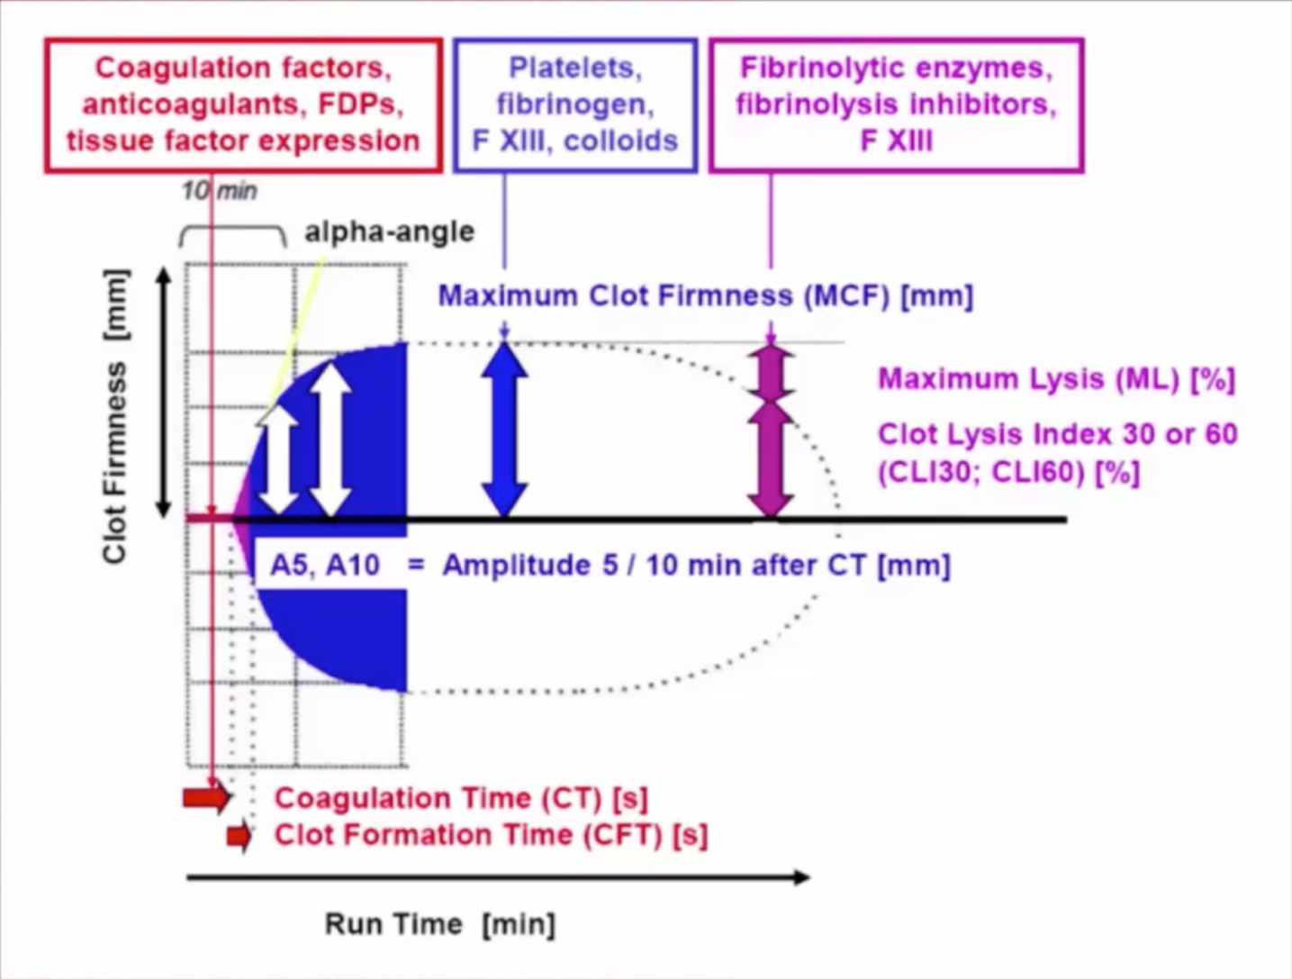

Components of ROTEM

Slide 4
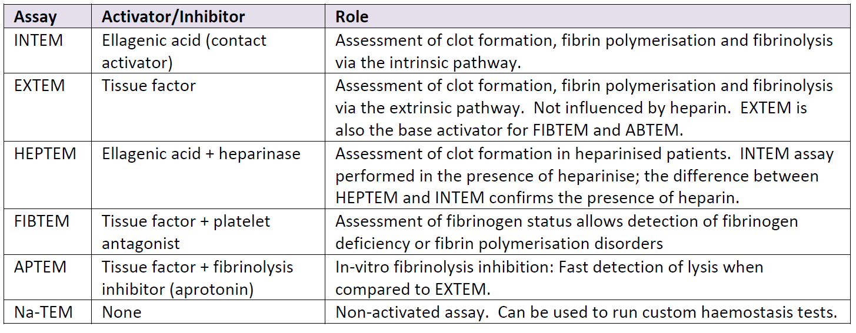
ROREM assays

Slide 5
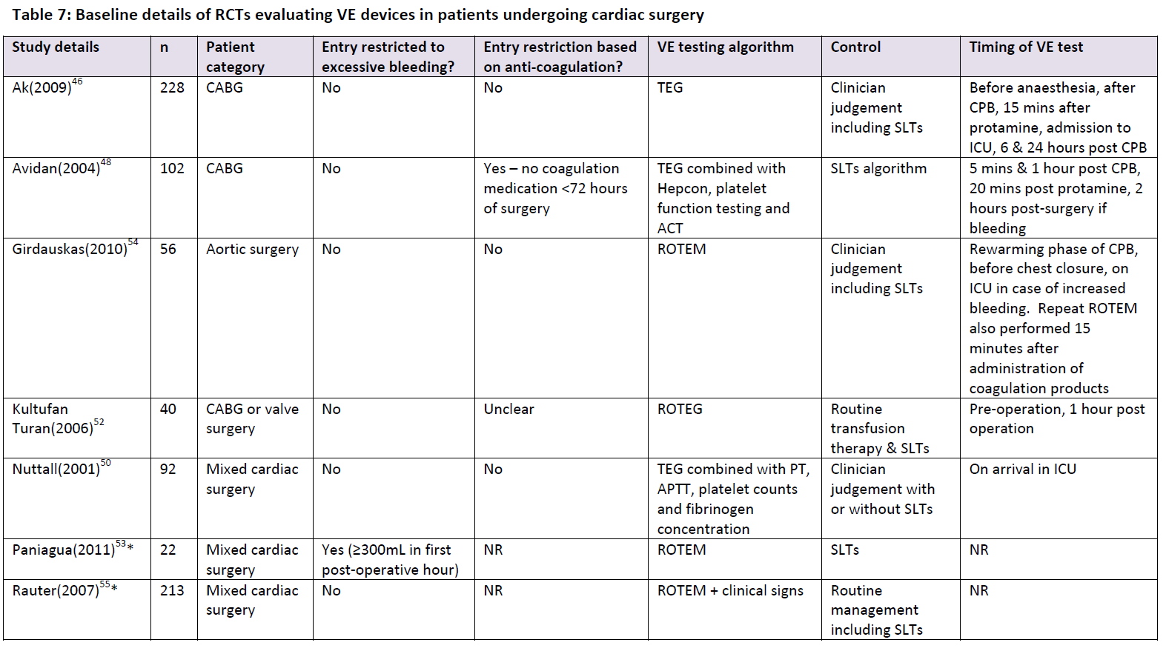
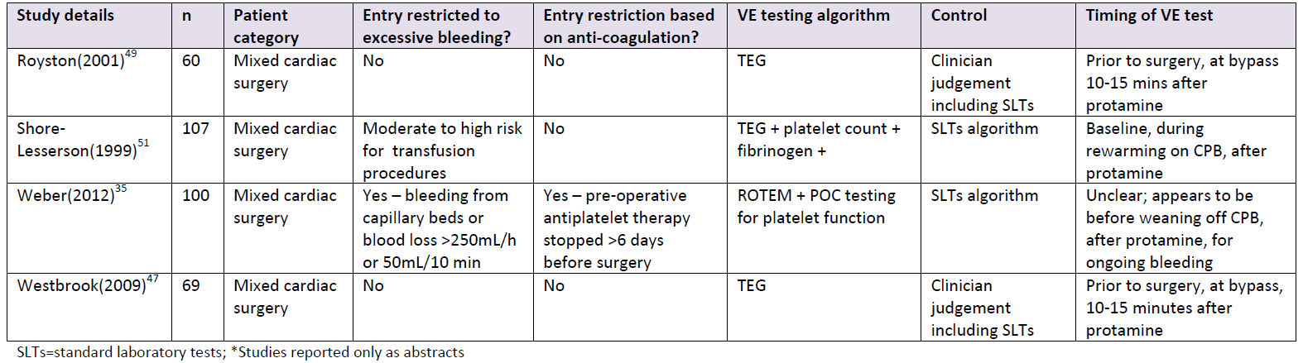
Clinical trials evaluating TEG/ROTEM in cardiac surgery- A meta-analysis

Slide 6
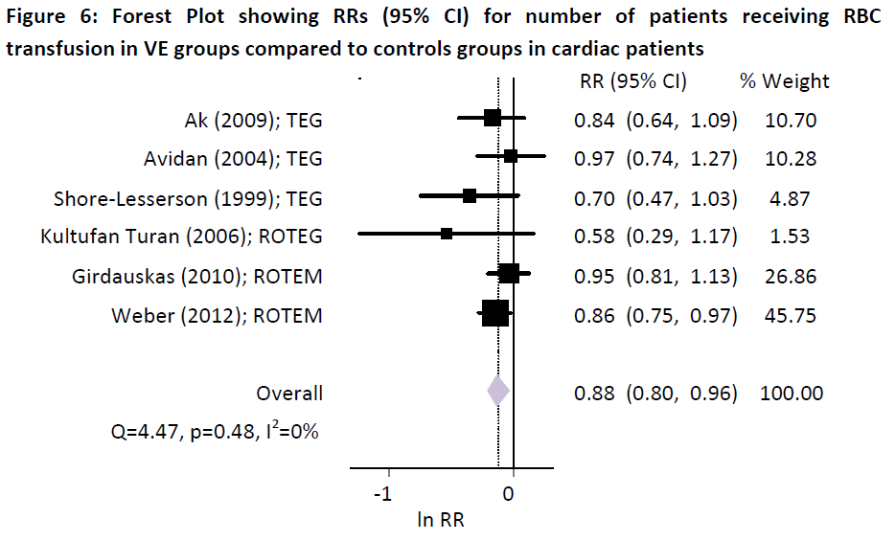


Slide 7
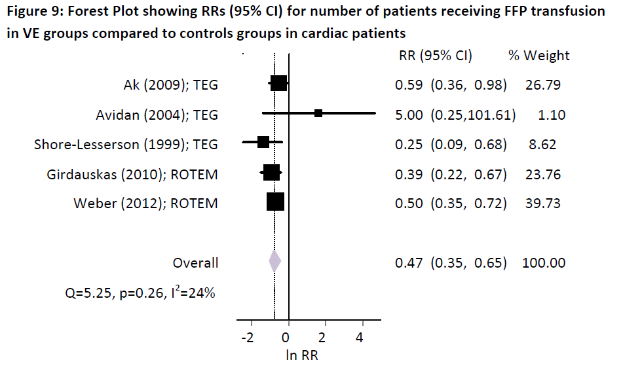

Slide 8
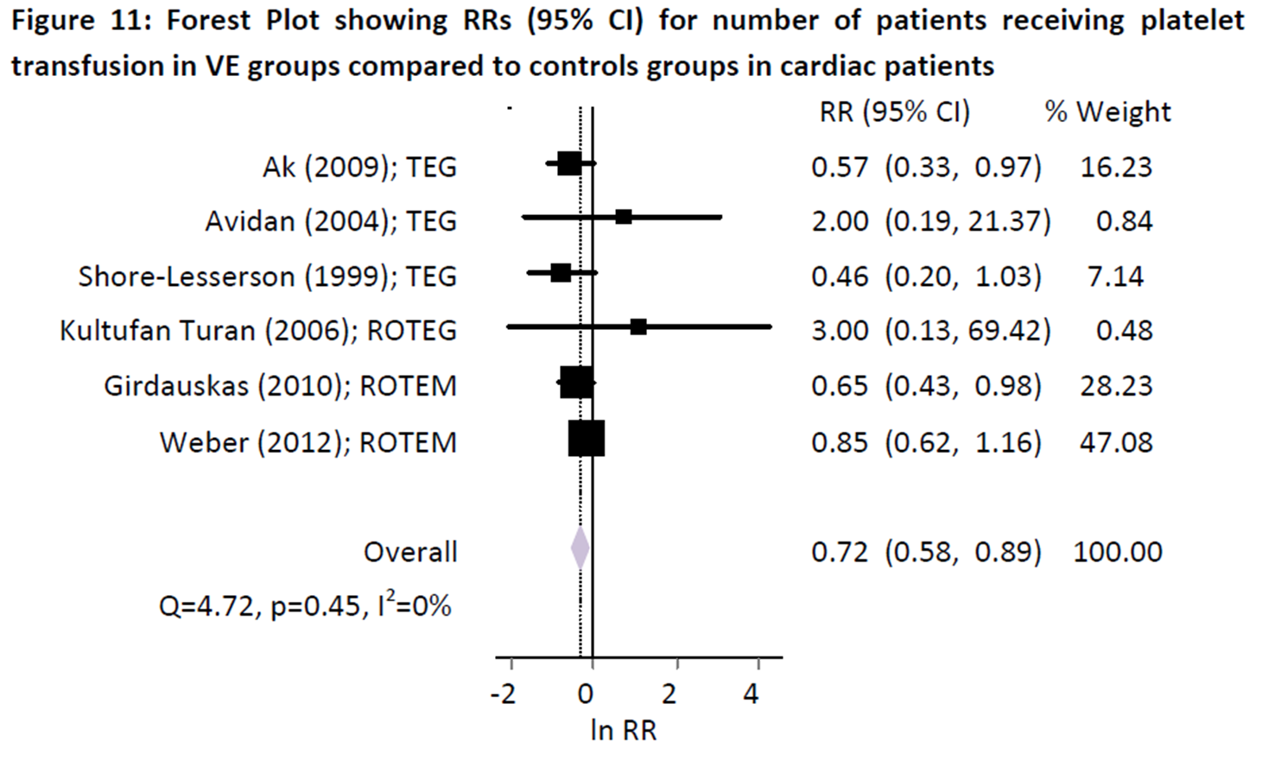

Slide 9
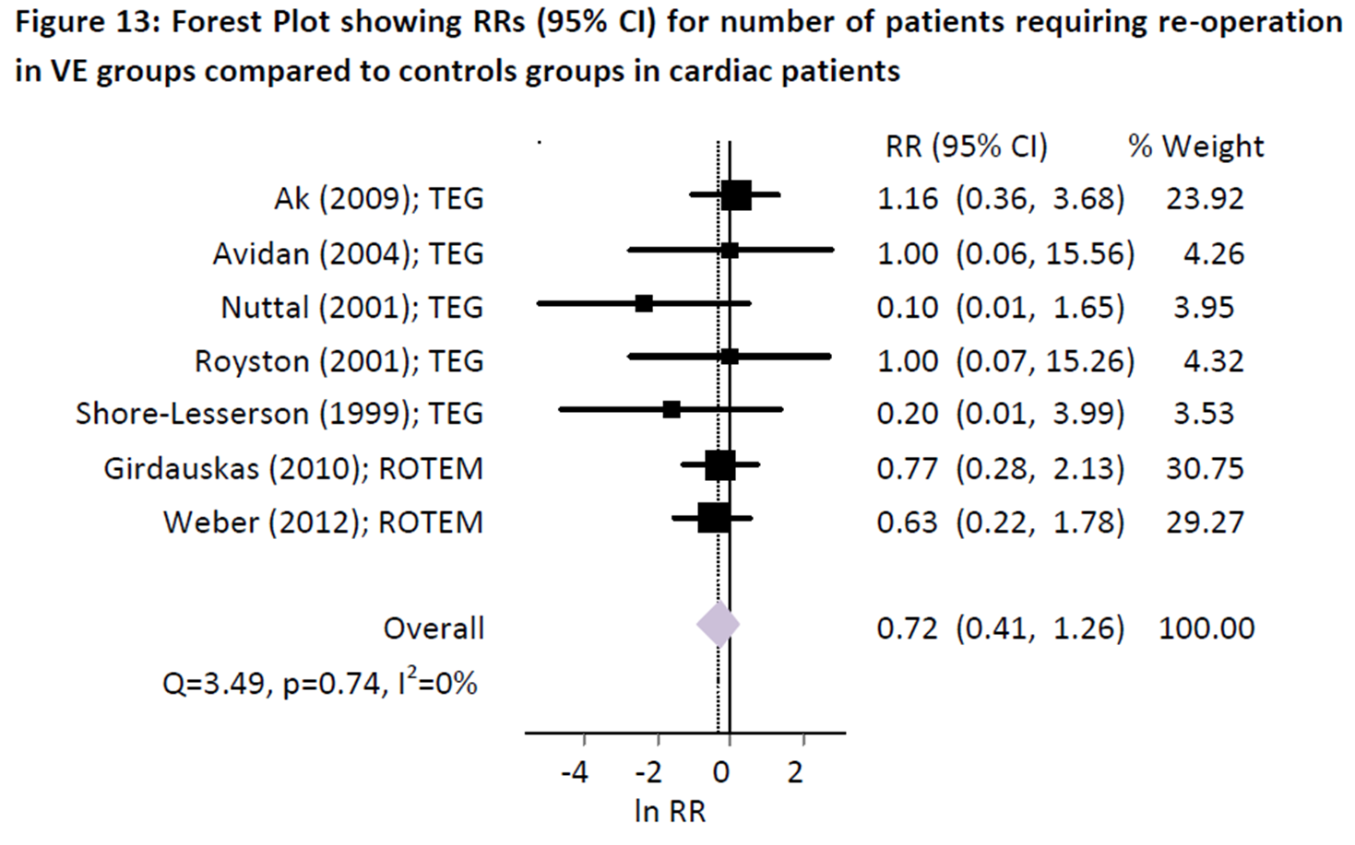

Slide 10
Number of ROTEM tests in 2014 (1393)
[9 months] in Rajaie hospital
Months (2014) | No. of ROTEM | No. of Operations
April | 15 | 251
May | 15 | 441
June | 55 | 376
July | 70 | 426
August | 80 | 402
September | 95 | 467
October | 73 | 415
November | 30 | 418
December | 85 | 417

Slide 11
Blood products transfusion
(No. of operations per year ~4800)
 | 1391 (2012) | 1392 (2013) | 1393 (2014)
RBC | 9469 | 9056 | 7908
FFP | 4663 | 4584 | 3896
Platelet | 2880 | 3294 | 2107

Slide 12
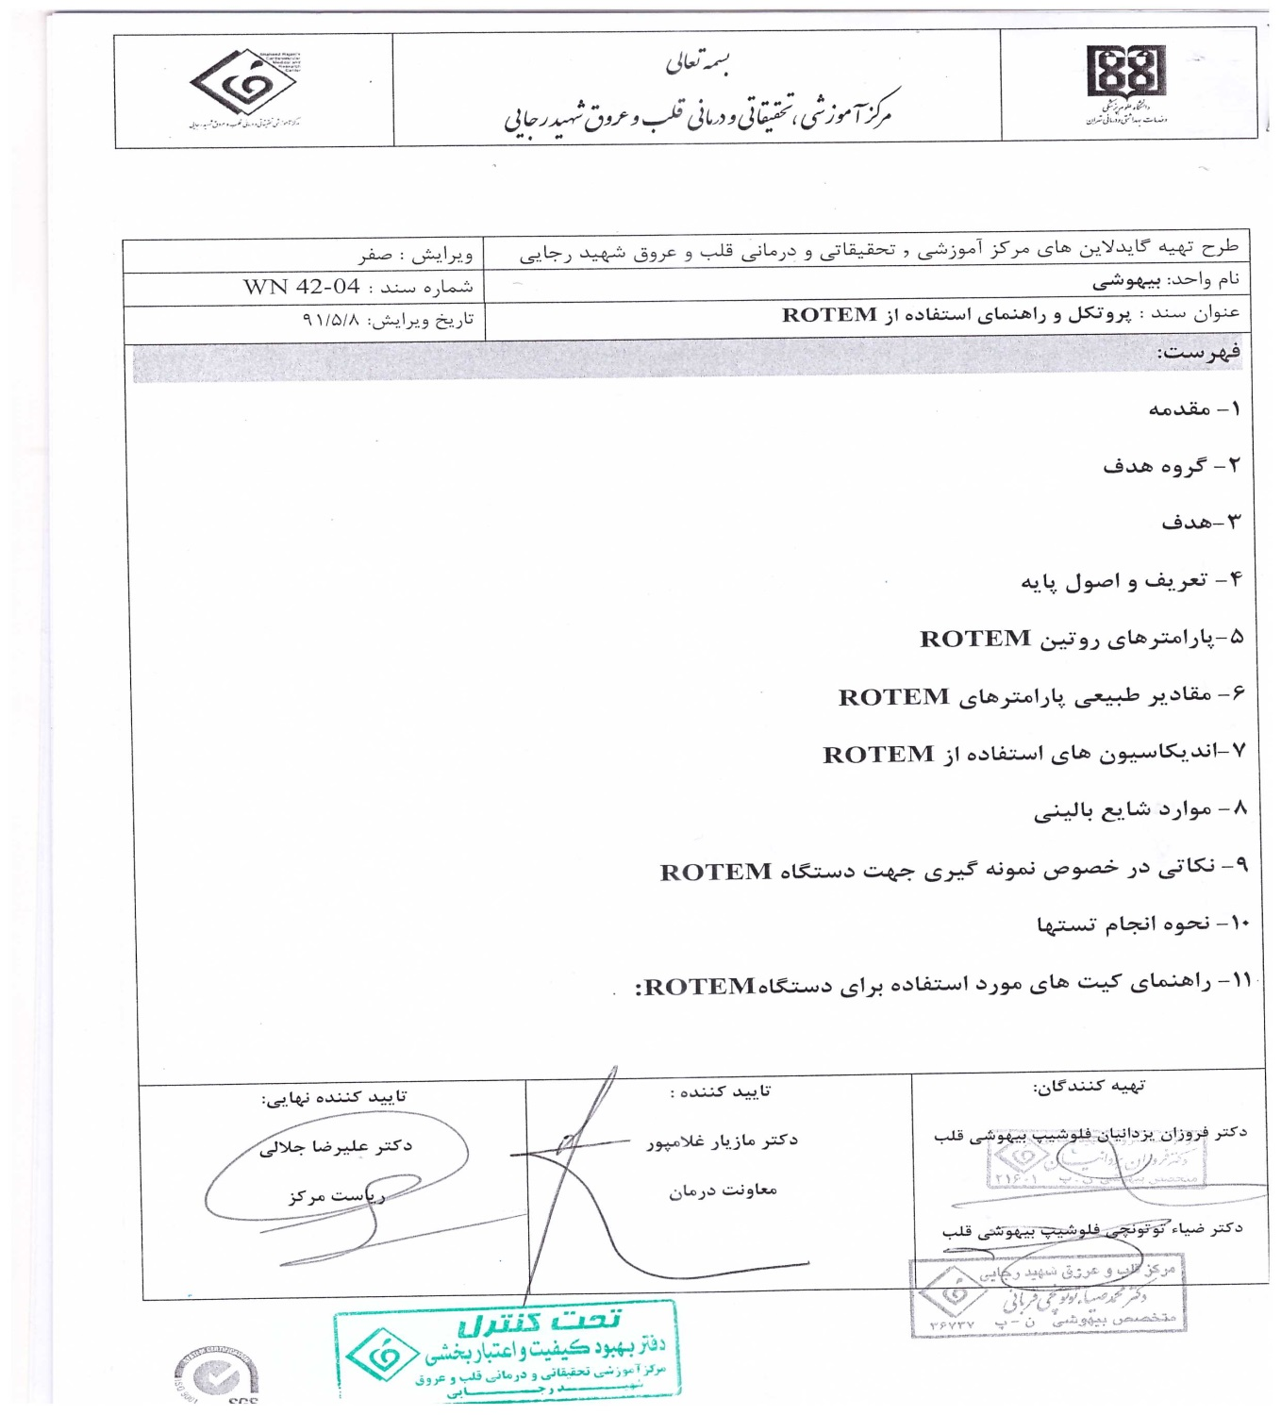
“Hemostatic Therapy Based on ROTEM” Protocol in
Rajaie Cardiovascular Medical & Research Center-Tehran

Slide 13
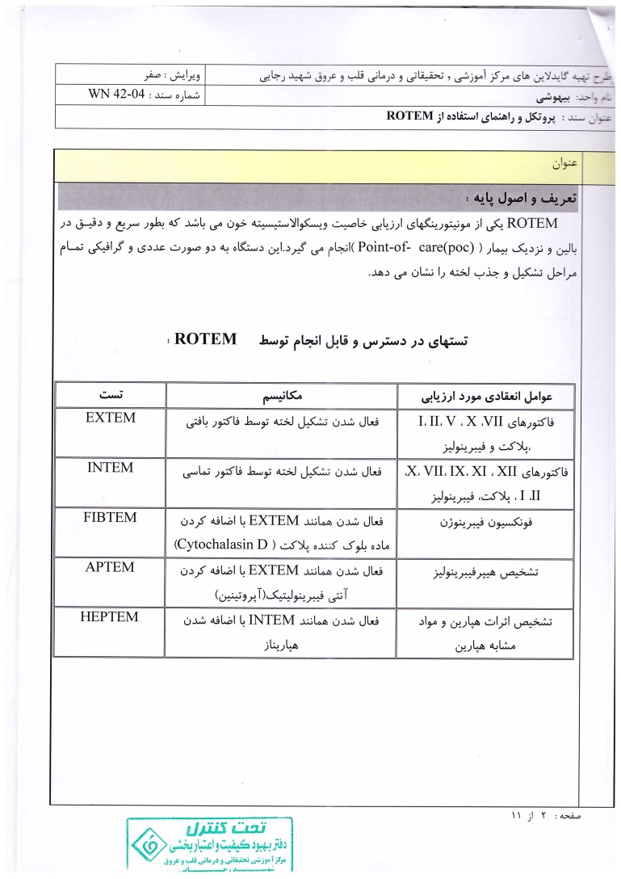

Slide 14
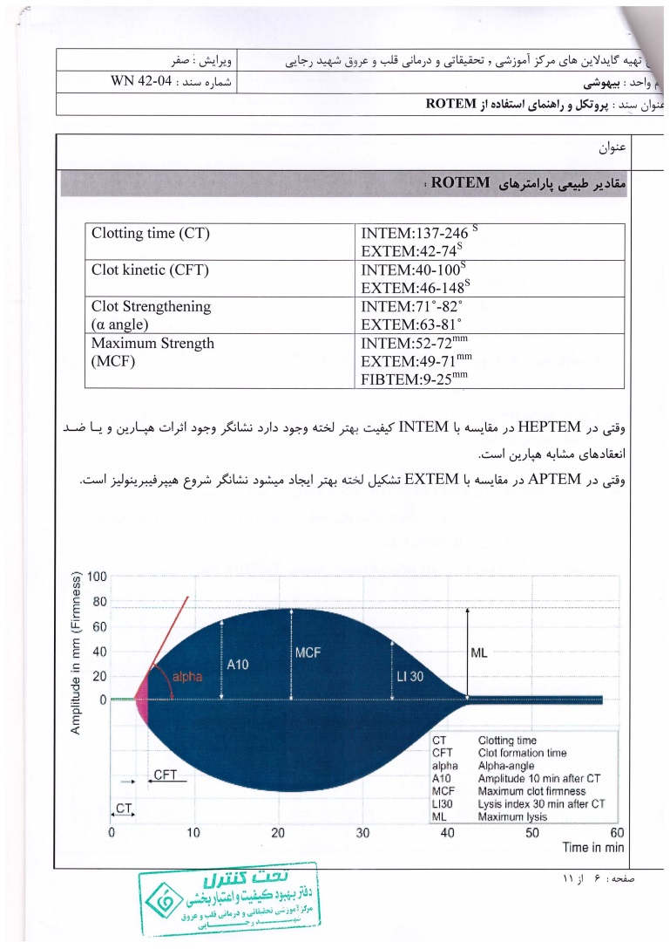

Slide 15
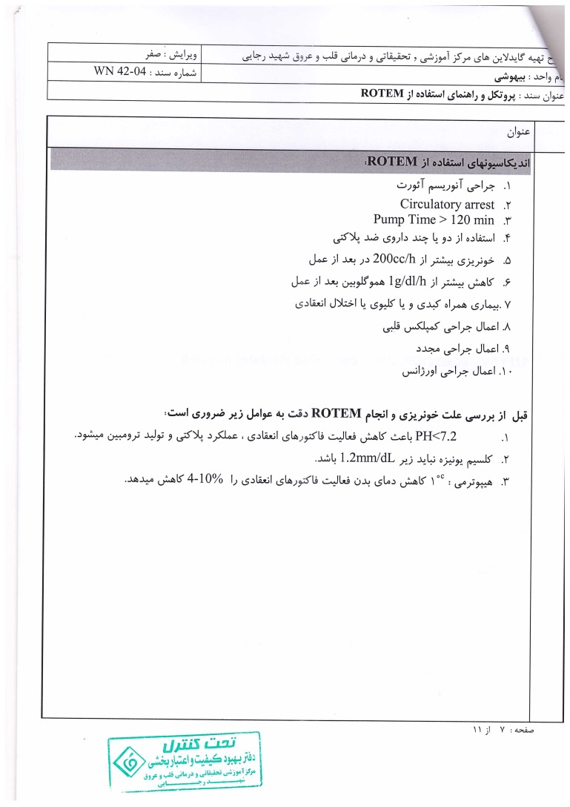

Slide 16
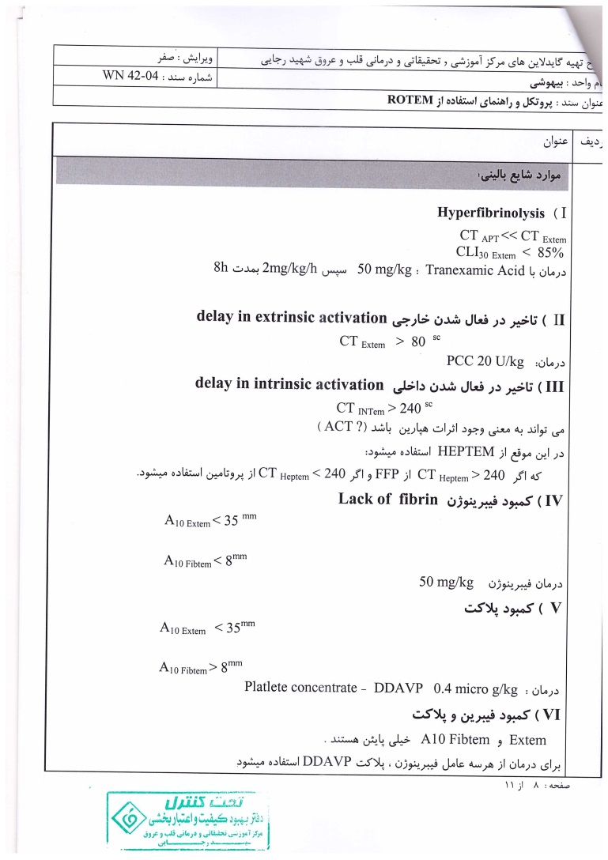

Slide 17
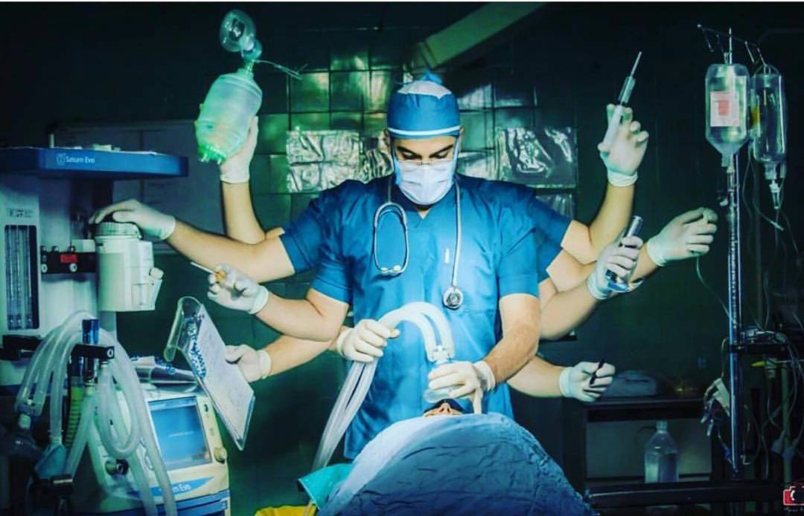

Slide 18
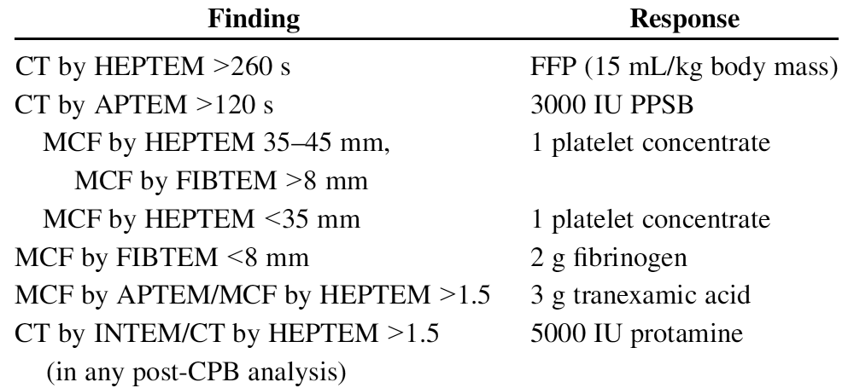

Coagulation management based on ROTEM
PCC

Slide 19
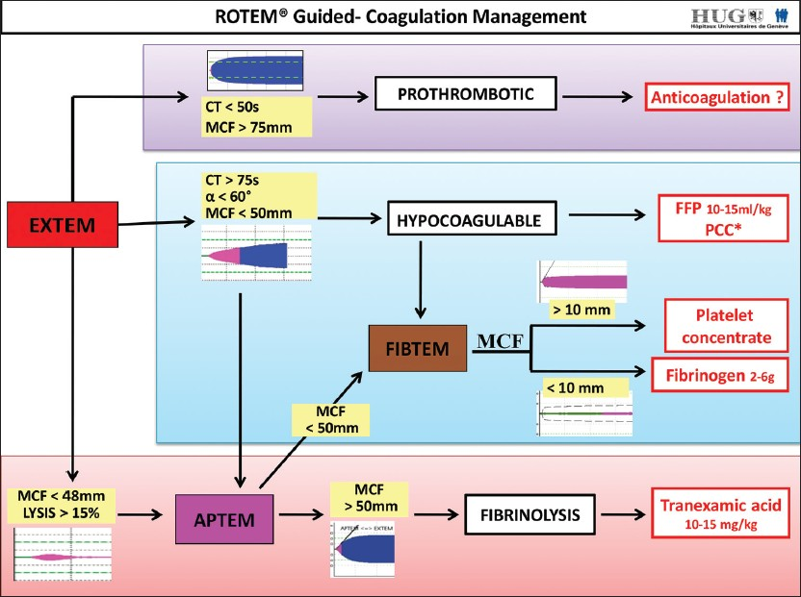

Slide 20
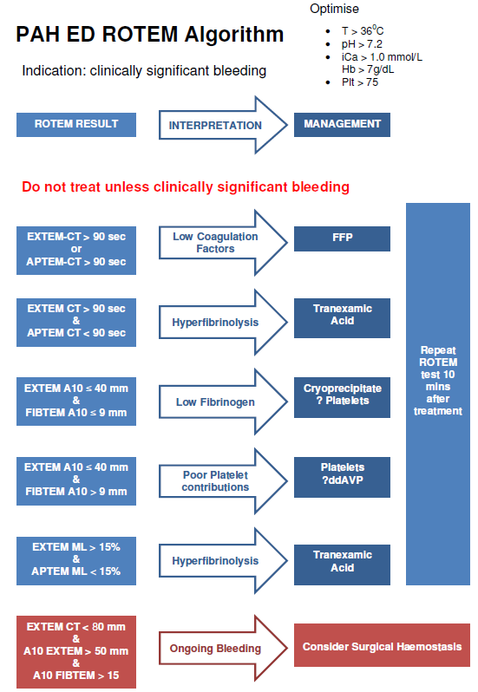

Slide 21
Case Report (1)
A 28 yrs old man with diagnosis of congenital aortic stenosis.
Underwent open heart surgery 5 times in 19-23 yrs ago (AV repair and AVR with homograft, AVR-prosthetic, Re-do AVR) and MVR 10 yrs ago.
Candidate for AV prosthesis pannus resection and CABG (SVG on RCA)
Echo: Severe RV systolic dysfunction, LVEF=45%
AVR+CABG was done; CPB time=2hrs 45min; Temp=30^{oc}

Slide 22
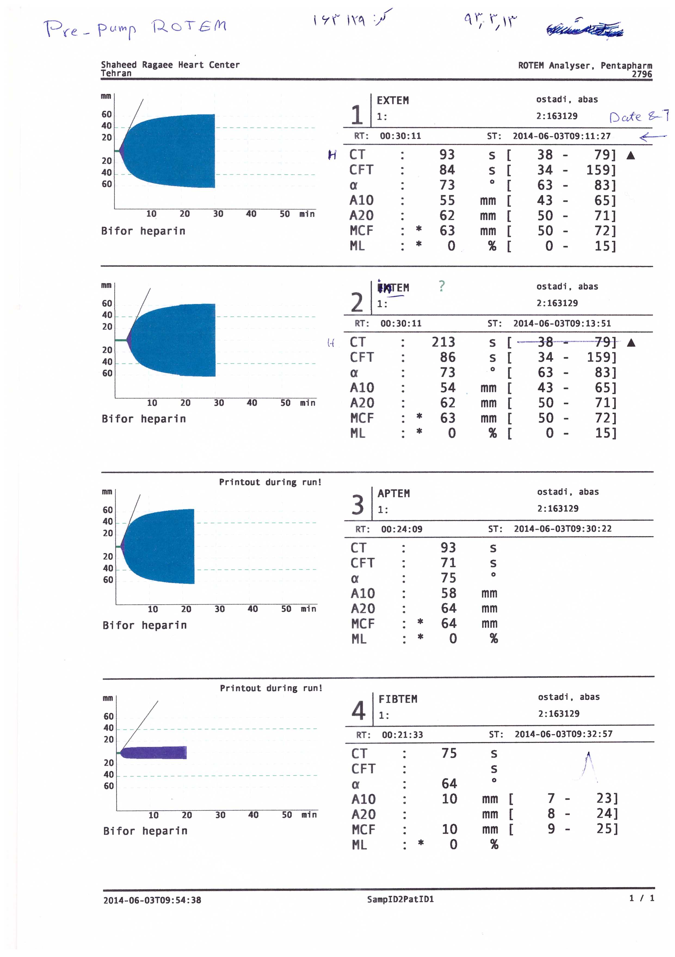


Baseline ROTEM
INTEM

Slide 23
There was significant oozing after CPB
Platelet concentrate= 5 units
FFP= 3 units
Hb=6.3 g/dl Packed RBC= 2 units
Fibrinogen= 2 gr
(There is no ROTEM immediately after CPB unfortunately!)
Sternum left open, and was closed the day after surgery (Mostly due to RV distention).

Slide 24
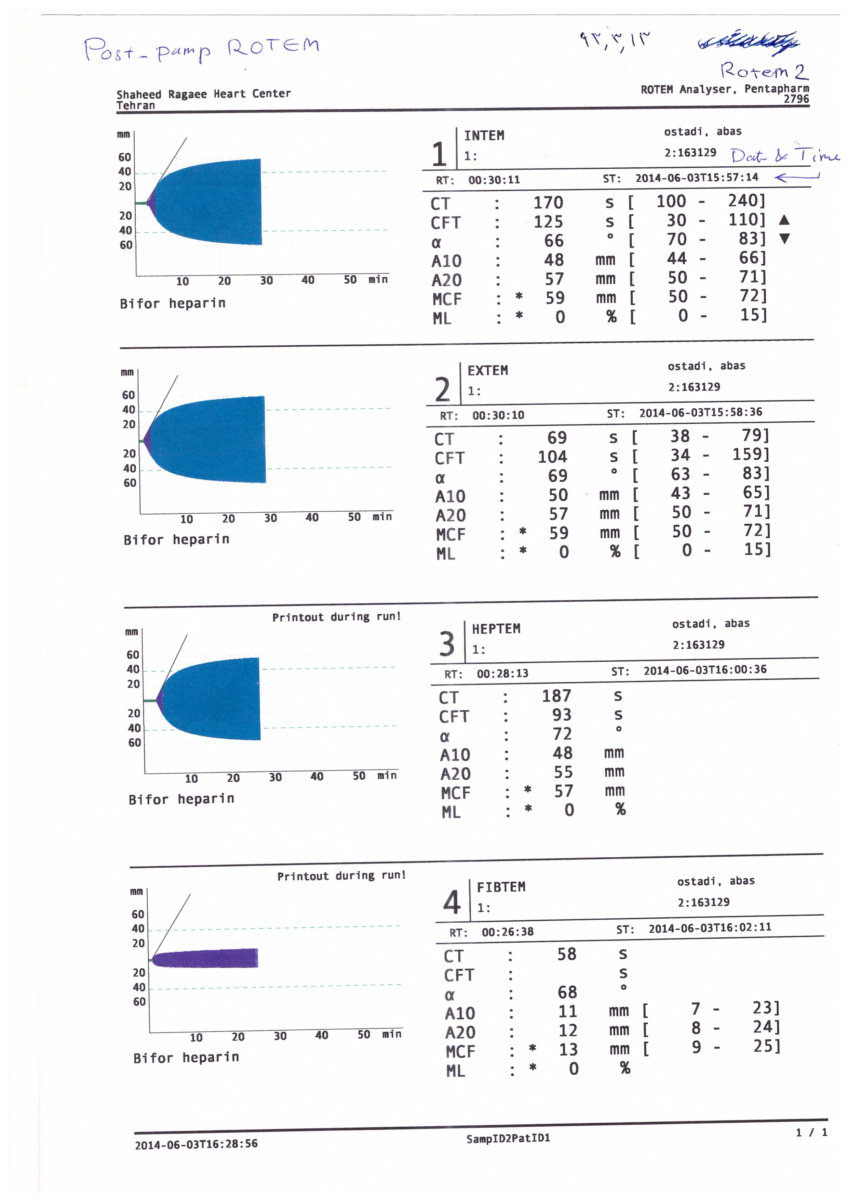

Post-CPB ROTEM (after hemostatic therapy)

Slide 25
Case Report (2)
A 18 yrs old man with pulmonary atresia+ Large VSD.
Hx of modified BT shunt 9 yrs ago.
Candidate for VSD closure+ modified Rastelly procedure (conduit + PVR).
Op time=7hr; CPB time=4hr 50min; lowest Temp=28^{oc}
Baseline Hb=20 gr/dl, lowest Hb=10.6 gr/dl.

Slide 26
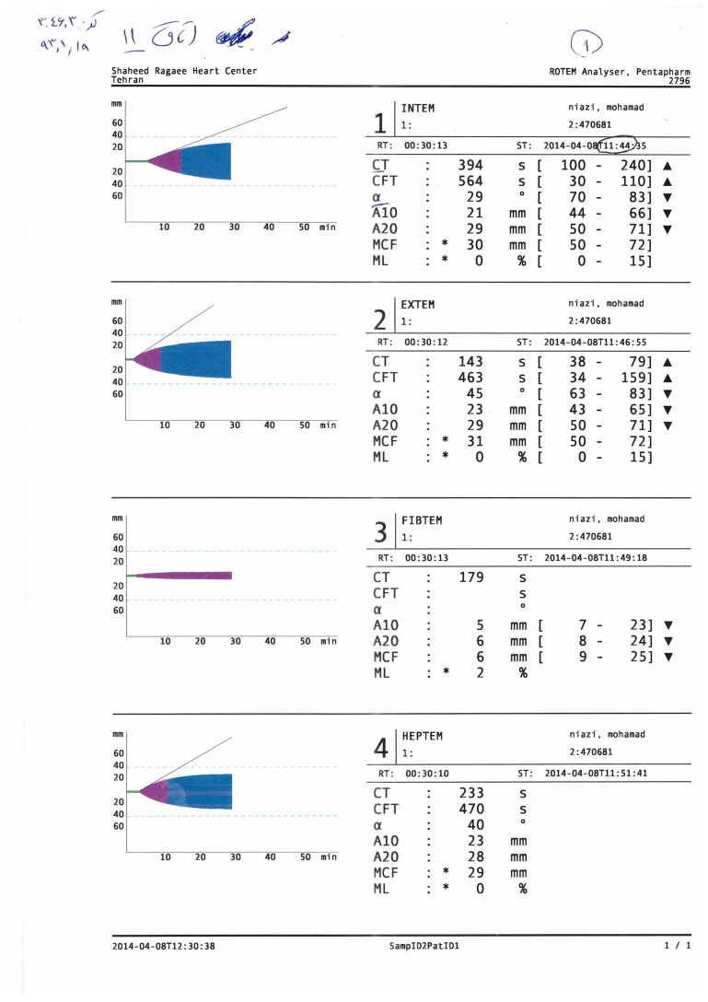
Baseline ROTEM

Slide 27
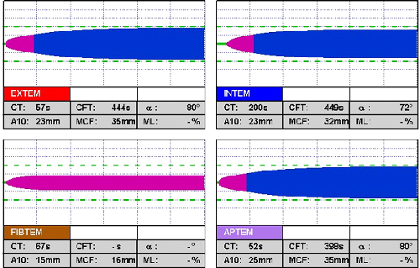
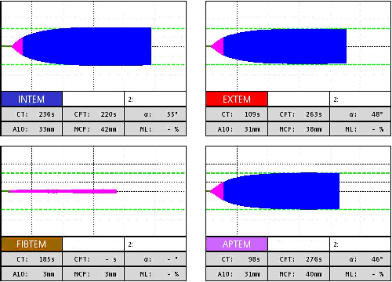
Results Interpretation
Platelet Deficiency:
Fibrinogen Deficiency:

Slide 28
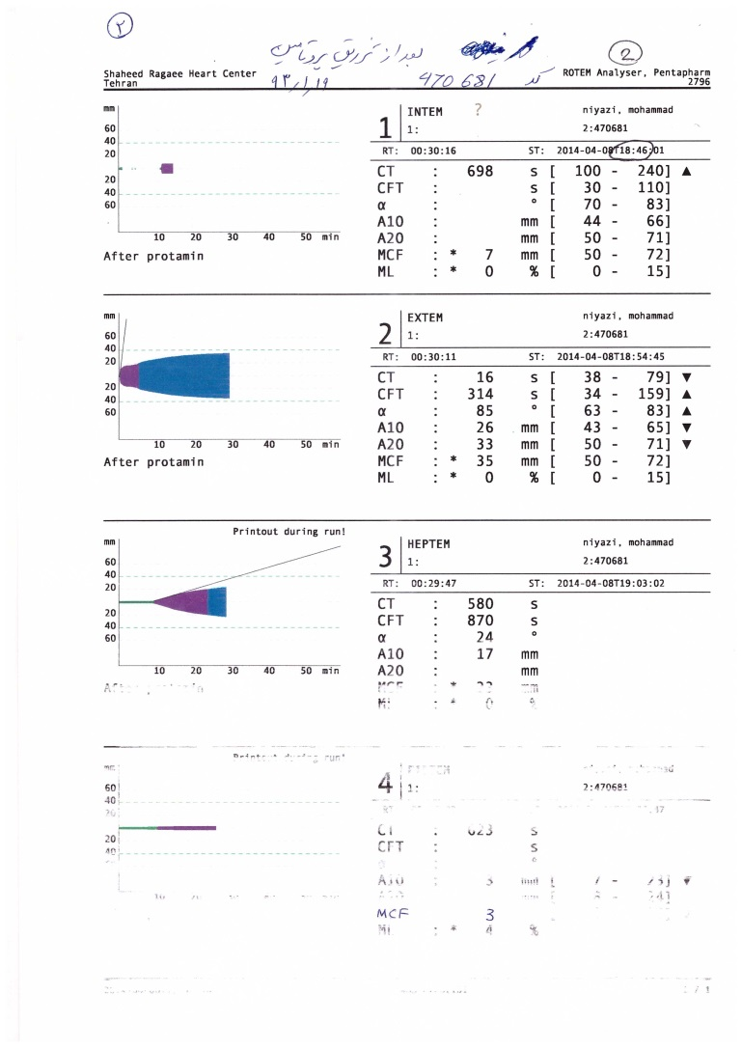
Post-CPB ROTEM (after protamine, before hemostatic therapy)

Slide 29
Hemostatic therapy
Platelet concentrate= 2 units
FFP= 2 units
Fibrinogen= 2 gr
Prothrombine complex concentrate (PCC)= 1000 IU (2 vials)

Slide 30
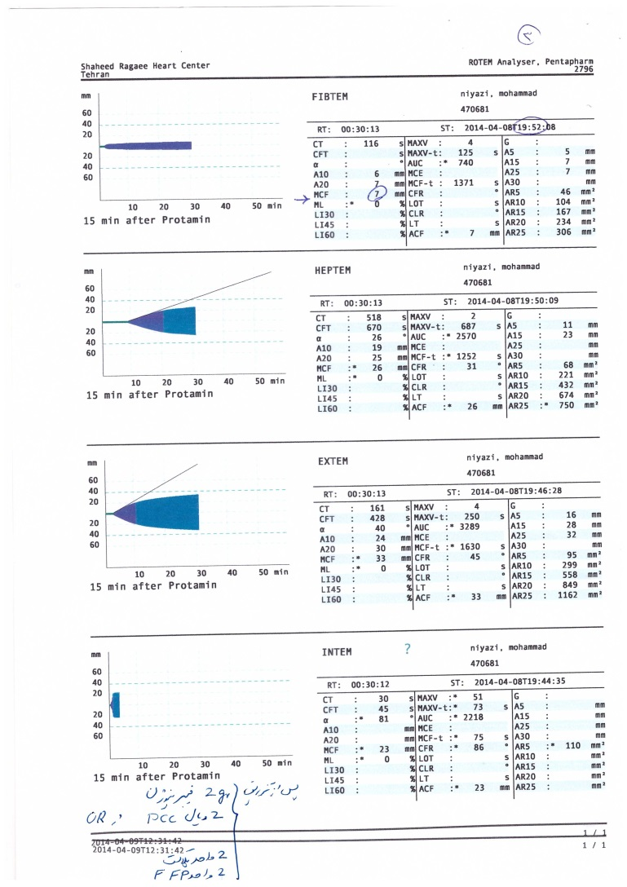
Post-CPB ROTEM 2 (after hemostatic therapy)

Slide 31
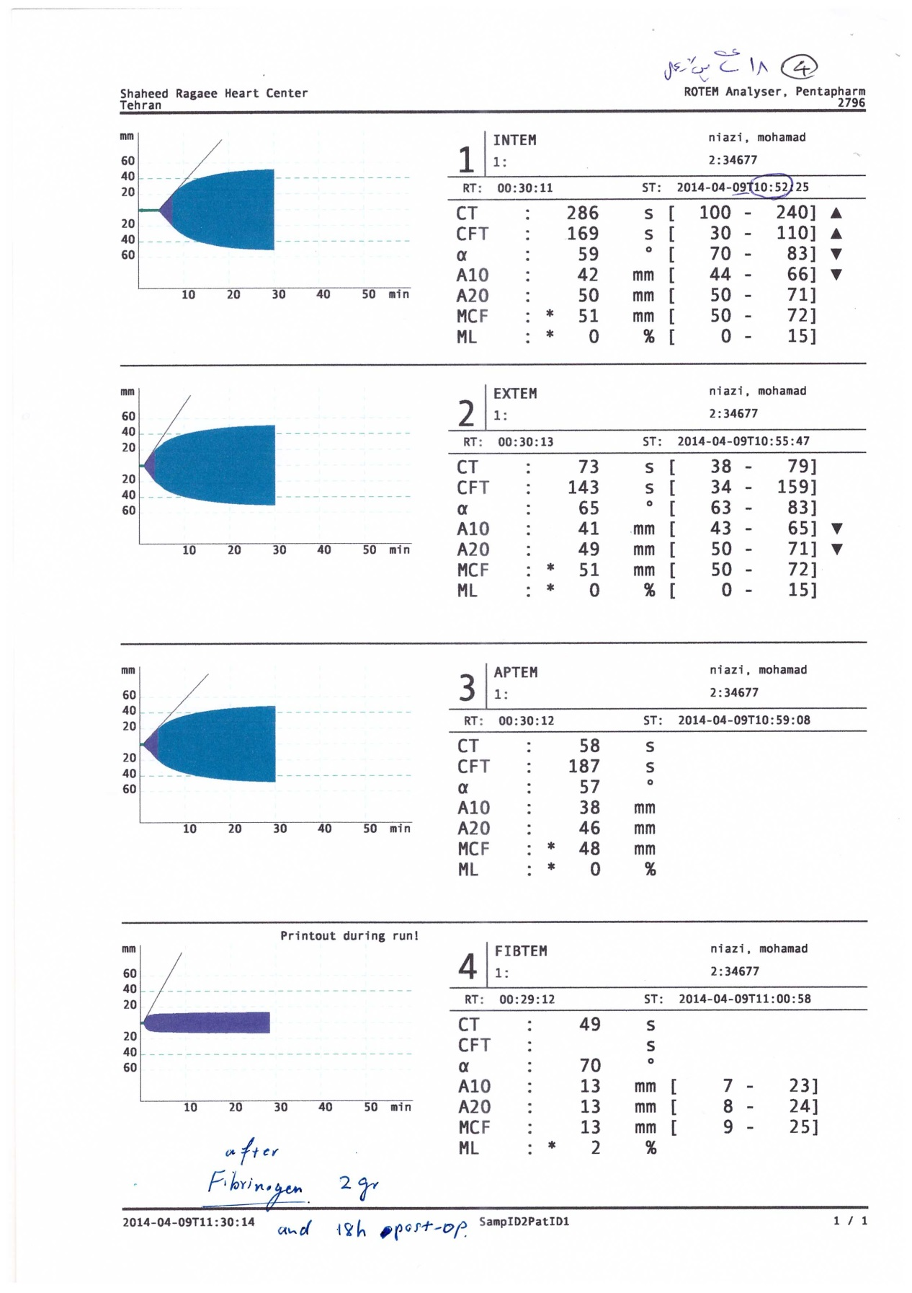
Post-op day 1 ROTEM (after 2nd fibrinogen 2 gr)

Slide 32
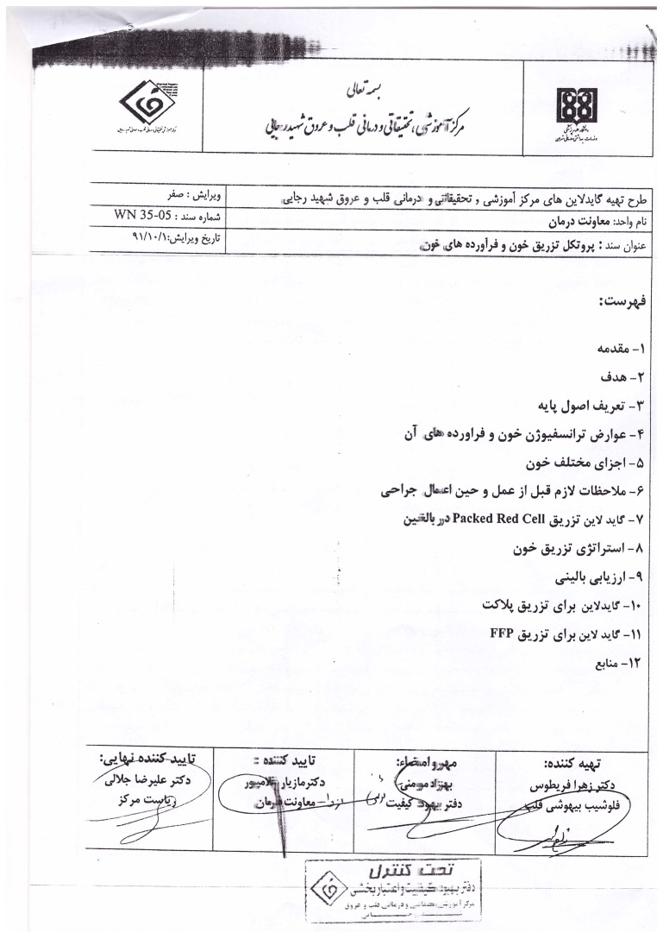

Slide 33
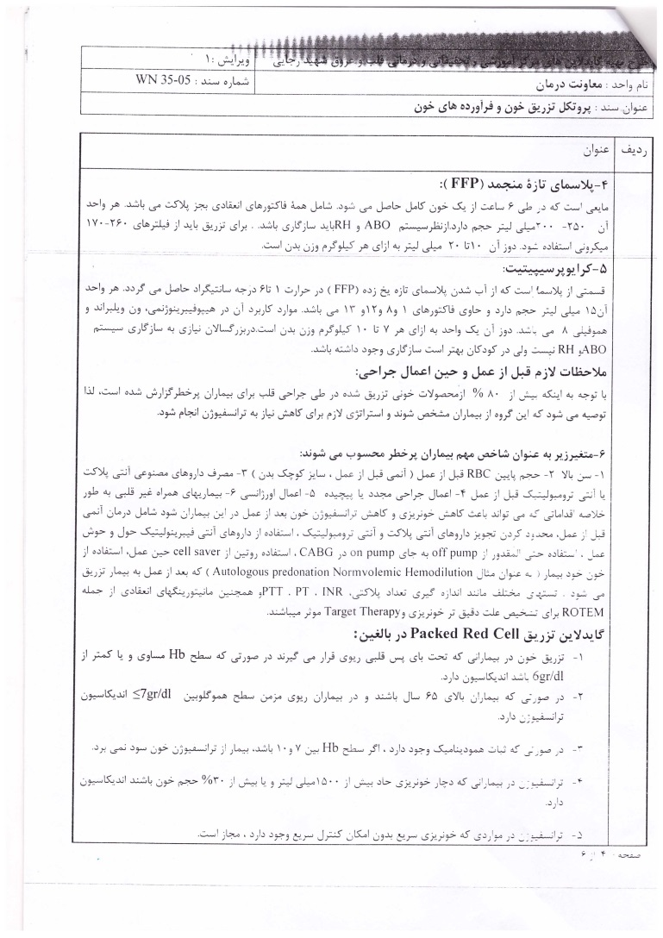

Slide 34
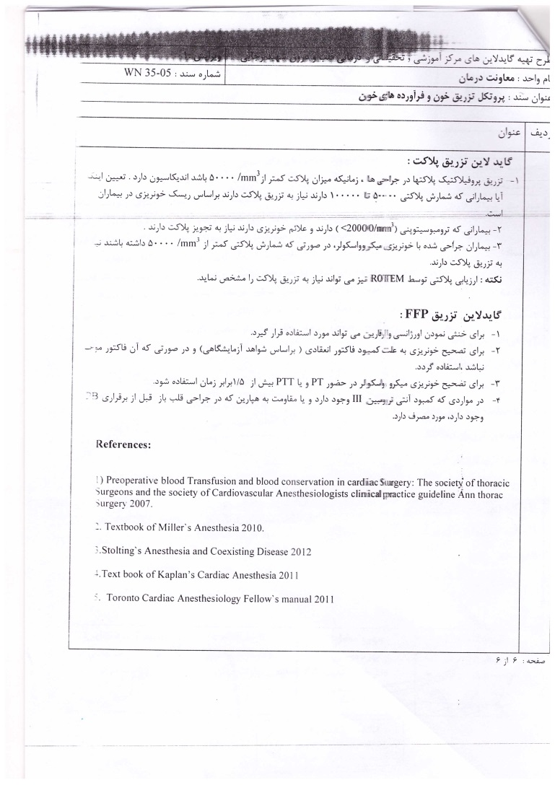

Slide 35
