Slide 1


Slide 2
Pulmonary Artery Catheter Monitoring
RASOUL AZARFARIN, MD, FACC
Professor of Anesthesiology
Rajaie Cardiovascular Medical & Research Center

Slide 3
Introduction
Swan-Ganz catheter has been in use for almost 30 years
Initially developed for the management of acute myocardial infarction
Now, widespread use in the management of a variety of critical illnesses and surgical procedures

Slide 4
PAC
Advantages
  Provide lot of important haemodynamic parameters
  Sampling site for SvO2
Disadvantages
  Costly
  Invasive
  Multiple complications (eg arrhythmia, catheter looping, balloon rupture, PA injury, pulmonary infarction etc)
  Mortality not reduced and can be even higher
  Crit Care Med 2003;31: 2734-2741
  JAMA 1996;276 889-897

Slide 5
INDICATION
Haemodynamic measurement(cardiac output, stroke volume, systemic vascular resistance)
Measurement of right heart pressure(RAP,PAP)
Acute pulmonary hypertension
Pulmonary embolism
Cardiac tamponade
Estimation or preload/left heart filling(PAOP)
Derivation of oxygen variables(VO2,DO2)

Slide 6
Indications
Diagnostic indications:
  Shock states
  Differentiation of high vs low pressure pulmonary edema
  Primary pulmonary hypertension
  Intracardiac shunts
  Cardiac tamponade
  Pulmonary embolus
  Monitoring and management of complicated acute myocardial infarction
  Assessing hemodynamic response to therapies
  Management of multiorgan failure
  Severe burns
  Hemodynamic instability after cardiac surgery
  Assessment of response to treatment in patients with primary pulmonary hypertension
Therapeutic indications:
  Aspiration of air emboli

Slide 7
PAC remains used for the management of patients with RVF , PH , weaning failure from cardiac origin and management of complex circulatory conditions in which the knowledge of PAP, PAOP and oxygenation parameters is considered to be important

Slide 8
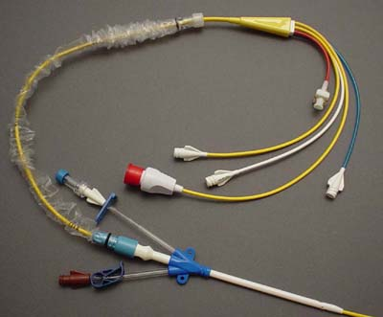
Components of Swan-Ganz
Normally has four[4] ports
Proximal port – [Blue] used to measure central venous pressure/RAP and injectate port for measurement of cardiac output
Distal port – [Yellow] used to measure pulmonary artery pressure
Balloon port – [Red] used to determine pulmonary wedge pressure;1.5 special syringe is connected
Infusion port – [White] used for fluid infusion

Slide 9
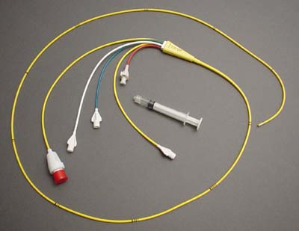
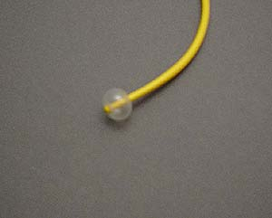
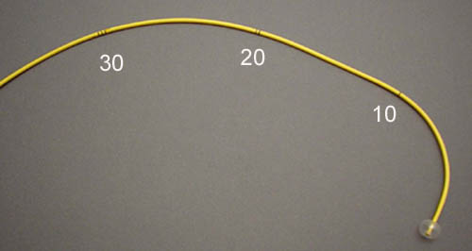

Slide 10
Distances (rough estimates)
RIJ:
  Right Atrium: 20-25 cm
  Right Ventricle: 30-35 cm
  PA: 40-45 cm
  Wedge 45-55
If LIJ or R Ext Jugular, add 5-10 cm
If Femoral: add 15 cm
If Antecubital: add 30-35 cm
Common problems: coiling in the right atrium or right ventricle – deflate balloon, withdrawn to 20 and refloat

Slide 11
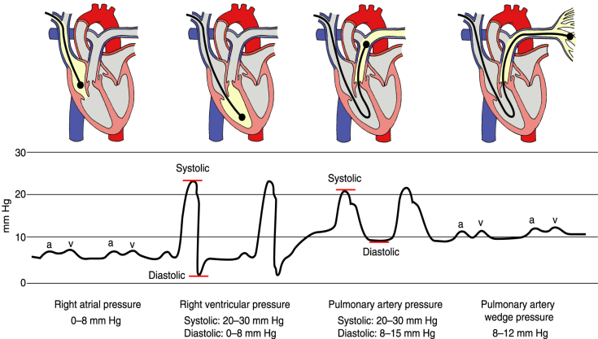
PULMONARY ARTERIAL PRESSURE MONITORING

Slide 12
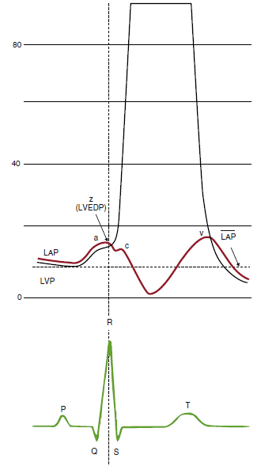

Slide 13
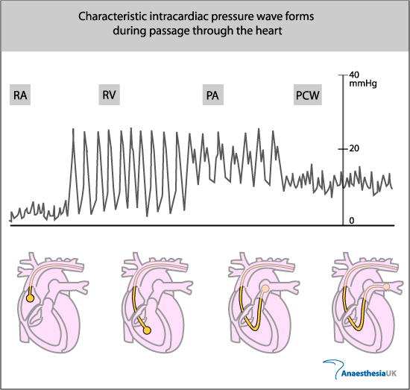
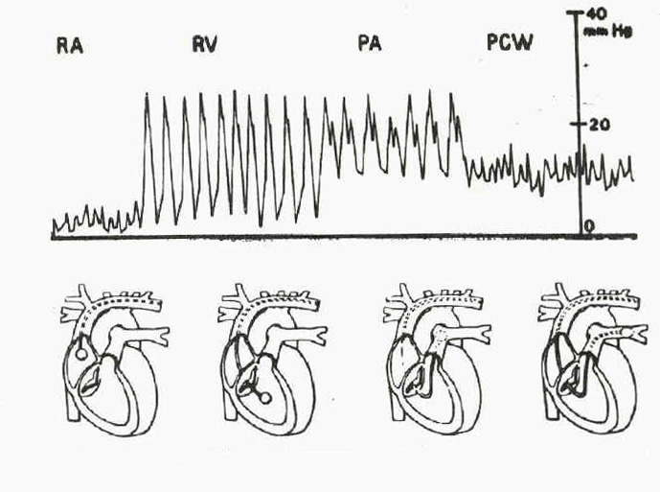

Slide 14
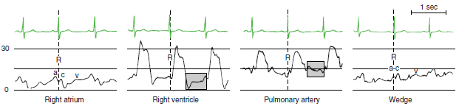

Slide 15
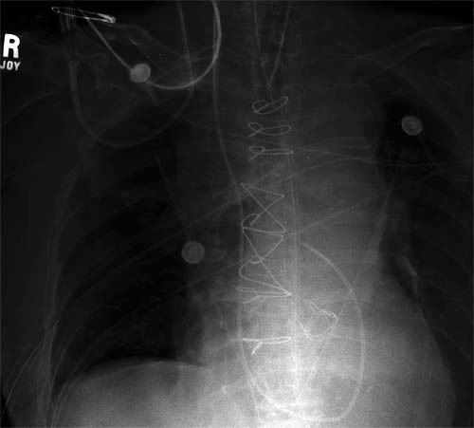
Conformation

Slide 16
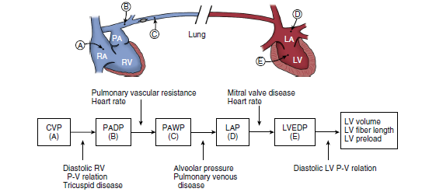

Slide 17
Pulmonary Artery Occlusive Pressure (PAOP)
Normal mean value
8-12 mm Hg
Hypovolemia
Low (< 8 mm Hg)
hypervolemia
High (>12 mm Hg)

Slide 18
PAOP
Reflects left ventricular end diastolic volume
  Assumes a static column
  of blood from ventricle to catheter during diastole and consistent compliance
Abnormalities are viewed in the context of SV/SI
  If high (>18) implies left ventricular dysfunction, especially if SV is low
  If low (< 8) implies hypovolemia especially if SV is low

Slide 19
Pulmonary Artery Occlusive Pressure (PAOP)
Also known as:
Pulmonary capillary wedge pressure
PCWP
PWP
PAW
Wedge pressure
Wedge

Slide 20
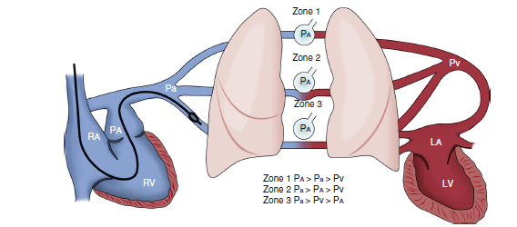

Slide 21
PAP WAVEFORM
Similar in appearance to arterial waveform
Waves
Systolic pressure
Dicrotic notch
End diastolic pressure

Slide 22
PAP
Normal values
PA systolic pressure = 20-30 mm Hg
PA diastolic pressure = 8-12 mm Hg
About 25/10
Low
Volume depletion
Drugs
High
Pulmonary HTN
Pulmonary Embolus
Mitral stenosis
LV failure
Septal wall defects

Slide 23
What does a PAC tell us?
Direct measurements
  CVP
  PA (systolic and diasotolic)
  PAOP (wedge)
  S_{v}O₂ (mixed)
Calculated data
  Stroke volume (SV/SVI)
  Cardiac output (CO/CI)
  Vascular resistance (SVR,PVR)
  Oxygen delivery
Extended calculations
  CCO
  Stroke work
  End diastolic volume, EF

Slide 24
THERMODILUTION CARDIAC OUTPUT
MONITORING
A known volume of iced or room temperature fluid is injected as a bolus into the proximal (right atrium) lumen of the PAC, and the change in the pulmonary artery blood temperature is recorded by the thermistor at the catheter tip

Slide 25
Thermodilution Cardiac Output
Monitoring has become the de facto clinical standard for measuring CO because of its ease of implementation and the long clinical experience with its use in various settings

Slide 26
CO Waveforms

Slide 27
Following the trend in cardiac output is probably more clinically useful than emphasizing any absolute value

Slide 28
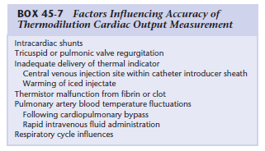

Slide 29
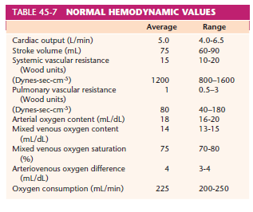

Slide 30
Fick Method
CO = VO₂ / [C_{a}O₂ – C_{v}O₂] * 10
  S_{a}O₂ and S_{v}O₂ often substituted
    CO = VO₂ / [S_{a}O₂ – S_{v}O₂] * Hgb * 1.34* 10
  VO₂ is not usually measured
    Can use 3.5 mL/kg or 125 mL/m²
    If metabolic rate is abnormal, the calculation may be incorrect

Slide 31
Papillary muscle ischemia or
Functional mitral regurgitation:
PAC monitoring is well suited to detect this event by revealing the onset of new regurgitant v waves in the pulmonary artery or wedge pressure traces

Slide 32
Continuous Cardiac Output
Newer generation catheter
  Uses continuous cardiac output measurements without need for bolusing
  Allows for right heart “volumetric” data
    RVEDV, RVEF, and RVSV
    RVSW and RVSWI
  Also provides continuous S_{v}O₂ measurements

Slide 33
Points to Remember
Limitations in hemodynamic monitoring
  Ventricular filling pressures do not always accurately reflect ventricular filling volume
    The pressure-volume relationship depends upon ventricular compliance
    If compliance changes, the pressure-volume relationship changes
  The PAOP is normally slightly (1-5 mm Hg) less than the PAD pressure
    This relationship stills exists with pulm hypertension due to LV failure
    However, with an ↑ PVR or tachycardia (>125 bpm) this relationship may breakdown and the PAD becomes significantly higher than the PAOP
  The PAOP may not equal LVEDP when
    there is high alveolar pressures
    when the catheter tip is above the left atrium
    severe hypovolemia
    tachycardia (130 bpm)
    in mitral stenosis.

Slide 34
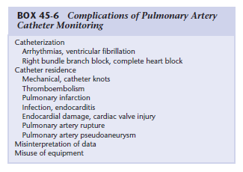

Slide 37


THANK YOU

