Slide 1


Slide 2
Resuscitation in cardiac arrest after cardiac surgery
Dr.Mohsen Ziyaeifard
Associated Professor
Cardiac Anesthetist
1395

Slide 3
European Association for Cardio-Thoracic Surgery (EACTS) 2010
Standards for Resuscitation
After Cardiac Surgery (Critical Care Nurse. 2015;35[2]:30-38)

Slide 4
Introduction
The incidence of cardiac arrest after cardiac surgery is around 0.7-2.9%
Relatively good outcome with 17–79% of patients suffering a cardiac arrest surviving to hospital discharge
The reason for this superior survival is the high incidence of reversible causes for the arrest :
VF in 25-50% of case
Major bleeding
Tamponade

Slide 5
Proposed protocol for cardiac surgical patients in ICU
We recommend that this protocol should be used in the ICU. It is not recommended for use outside of this setting.
1. Cardioversion
2. Identification of arrest and initiation of basic life support in the ICU
3.Doubtful diagnosis of cardiac arrest
4. Basic life support: external cardiac massage
5. Basic life support: airway
6. Infusions and syringe drivers
7. Administration of adrenaline (epinephrine)
8. Cardiac arrest in patients with an intra-aortic balloon pump
9. Management of the cardiac arrest

Slide 6
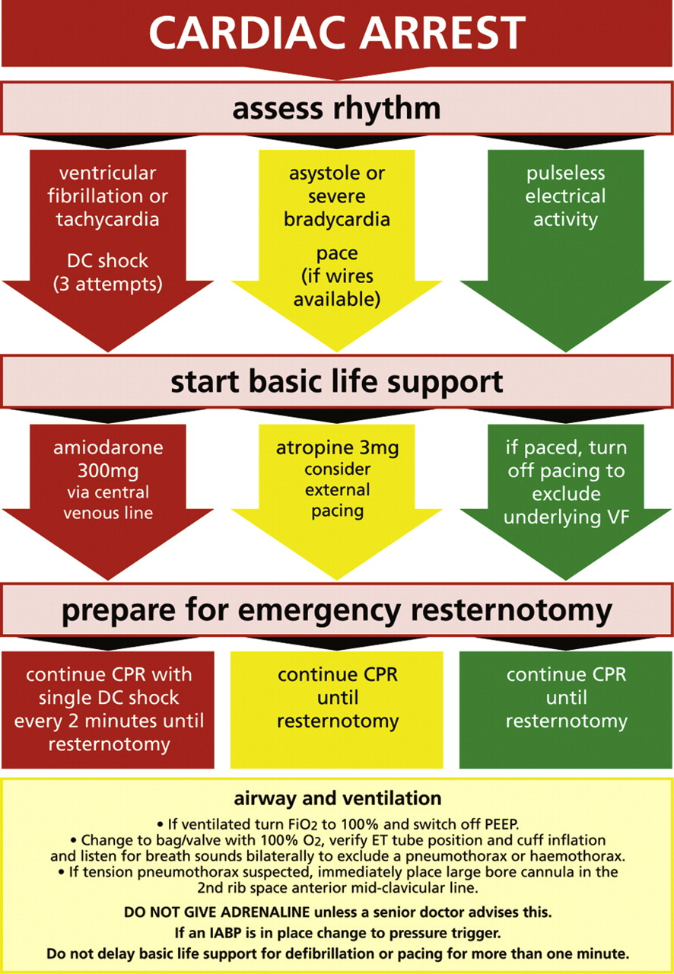

Slide 7
Cardioversion
Cardiac surgical patients are sufficiently different from other patients for us to recommend an important departure from this guideline.
Firstly, the cardiac surgical patient in ICU usually has continuous arterial line, central venous line, pulse oximetry and ECG monitoring. Thus the arrest will be immediately identified, making early cardioversion more likely to be successful in restoring cardiac output without any ECM.
Secondly, immediate ECM is unnecessary in certain cases, and its use after cardiac surgery should be minimised due to the risk of trauma to the surgical site
Thirdly, if cardioversion is unsuccessful, rapid resternotomy may be indicated.

Slide 8
Cardioversion
Thus three successive attempts at defibrillation will increase the likelihood of restoreing cardiac output after a VF arrest while minimizing the delay to chest reopening where indicated as well as reducing the risk of trauma to recently operated cardiac structures and suture lines.

Slide 9
Identification of arrest and initiation of basic life support in the ICU
A potential cardiac arrest is most likely to be signalled by monitoring alarms
If you are the first person alerted to the possibility of an arrest you should immediately put your hand on to a central pulse (such as the femoral or carotid pulse) for up to 10 s.
If after 10 s there is no palpable central pulse and the arterial, CVP, PA and oximetry waveforms are flat, you should immediately instigate the cardiac arrest protocol. You should also loudly and clearly shout for help, for example:
‘cardiac arrest bed 4!’

Slide 10
Doubtful diagnosis of cardiac arrest
If in doubt feel for a central pulse for 10 s and look at all traces
If the ECG shows VF or asystole, call cardiac arrest immediately
If arterial and other pressure waveforms are pulseless then call cardiac arrest immediately

Slide 11
Basic life support External Cardiac Massage
If you have witnessed the change of rhythm to VF or pulseless VT then ECM may be delayed until three shocks have been given if a defibrillator is rapidly available (within 1 min)
If not, ECM should be immediately initiated
You should aim for the ‘systolic’ impulse over 60 mmHg for optimal cerebral perfusion.
Inability to achieve an acceptable compression-generated blood pressure may indicate that the cause of the arrest warrants immediate emergency resternotomy (massive bleeding or tamponade or tension pneumothorax) and chest reopening should be expediteed.

Slide 12
Basic life support airway
Immediately turn the oxygen up to 100%.
For ventilated patients, PEEP should be removed, and if you are happy to do so, the ventilator should be disconnected and a bag/valve used. Listen for breath sounds both sides and equal chest movement to identify a pneumothorax or a haemothorax if present.
If you suspect a tension pneumothorax, place a large bore needle into the 2nd intercostal space, anterior mid-clavicular line, followed either by a chest drain or opening of the pleura at resternotomy.
If you are happy with the airway and breathing, the patient may be reconnected to the ventilator

Slide 13
Infusions and syringe drivers
In an established cardiac arrest all infusions and syringe drivers should be stopped.
If there is concern about awareness then it is acceptable to continue the sedative infusions. Other infusions can be restarted as required by the clinical situation

Slide 14
Administration of adrenaline (epinephrine)
When arrest follows cardiac surgery, the chances of rapidly restoring cardiac output are good, and routine use of adrenaline in the arrest may result in dangerous subsequent hypertension.
Administration of adrenaline to be delayed until reversible causes of arrest are excluded.

Slide 15
Administration of adrenaline (epinephrine)
Adrenaline may be useful in the impending arrest or peri-arrest situation and may also be safely used in smaller doses such as 100–300 mcg boluses.
Neither adrenaline nor vasopressin should be given during the cardiac arrest unless directed by a senior clinician experienced in their use.

Slide 16
Cardiac arrest in patients with an intra-aortic balloon pump
VF or asystolic arrest is normally easy to recognize, but in PEA or in asystole with an active pacemaker, the ECG may continue to trigger the IABP and the arterial waveform may remain pulsatile even in the absence of cardiac output.

Slide 17
Cardiac arrest in patientswith an intra-aorticballoon pump
Cardiac arrest can be confirmed by the loss of the cardiac component of the IABP pressure trace.
In an arrest, ECG recordings are either absent or highly variable and subject to artifact from chest compression and other activity

Slide 18
Cardiac arrest in patients with an intra-aortic balloon pump
ECG trigger for the IABP is therefore not helpful.
Once cardiac arrest is established, the IABP should therefore be set to pressure trigger, with 1:1 counterpulsation at maximal augmentation. This will allow augmentation of cardiac massage and improved cardiopulmonary resuscitation , without interference from the ECG trace.
In cardiac arrest with an IABP in place, it should be set to pressure trigger.

Slide 19
Management of the cardiac arrest
Training should be given in these six key roles.
When the arrest occurs, each role should be assumed by appropriately trained individuals.
External cardiac massage
Airway and breathing
Defibrillation
Team leader
Drug administration
ICU co-ordinator

Slide 20
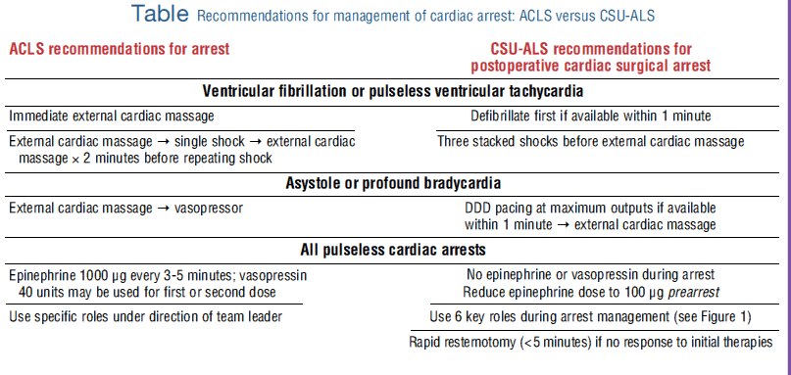

Slide 21
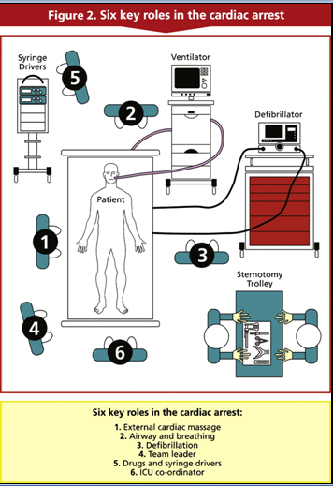
Six key roles in the cardiac arrest

Slide 22
Ventricular fibrillation or pulseless ventricular tachycardia
The use of a precordial thump in cardiac arrest
A precordial thump may be performed if within 10 s of the onset of VF or pulseless VT.
This should not delay cardioversion by defibrillation.

Slide 23
Immediate ECM versus immediate defibrillation or pacing
In an arrest after cardiac surgery, external cardiac massage can be deferred, a short duration of CPR (1-3 minutes) before
defibrillation of ventricular tachycardia or fibrillation (VT/VF) has not been shown to improve outcomes.
until initial defibrillation or pacing (as appropriate) have been attempted, provided this can be done in less than 1 min.

Slide 24
Number of attempts at defibrillation before resternotomy
In ventricular fibrillation or pulseless ventricular tachycardia 3 sequential shocks should be given without intervening CPR.
In VF or pulseless VT, emergency resternotomy should be performed after 3 failed attempts at defibrillation.
After 3 failed attempts at cardioversion for ventricular fibrillation/pulseless VT, a bolus of 300 mg of intravenous amiodarone should be given via the central line.

Slide 25
Cardiac arrest with ‘non-shockable’ rhythm
The initial arrest rhythm will be only amenable to defibrillation in 30–50% of patients
The remainder have other rhythms, which cannot be treated by defibrillation. Of these, predominant rhythms that may be amenable to pacing are severe bradycardia or asystole
For asystole or severe bradycardia, connect the epicardial pacing wires and set to DDD at 100 bpm at the maximum atrial and ventricular output voltages
In the absence of epicardial pacing wires, pacing can be achieved using external pacing pads
If the rhythm is pulseless electrical activity and a pacemaker is connected and functioning, then briefly turn the pacemaker off to exclude underlying ventricular fibrillation

Slide 26
Atropine
For patients with asystole or extreme bradycardia atropine should be given via the central line at a dose of 3 mg

Slide 27
Emergency resternotomy after non-VF/VT arrest
The ERC guidelines ask clinicians to consider the following as causes of the arrest:
hypoxia, hypovolaemia, hypo/hyperkalaemia, hypothermia, tension pneumothorax, thrombo-embolism, tamponade and toxins, the so-called four ‘H's and four ‘T's.
In contrast, cardiac surgical patients who have a non-VF/VT arrest with this rhythm may have tamponade, tension pneumothorax or severe hypovolaemia.
Prompt treatment is associated with an excellent outcome. Thus delays to resternotomy should be minimized
In non-shockable cardiac arrest which does not resolve after atropine and pacing, emergency resternotomy should be immediately performed

Slide 28
Proposed protocol for cardiac surgical patients in ICU

Slide 29
Conduct of emergency resternotomy
Internal versus external cardiac massage
Hallmark studies, have repeatedly demonstrated that external compressions are a poor substitute for internal massage, consistently delivering cerebral perfusion pressures that are 3- to 4-fold less than those of internal compressions and rarely exceed the 15 mm Hg end point required for neurological survival.
Internal cardiac massage is superior to external cardiac massage. In patients with a recent sternotomy in whom resuscitative efforts are likely to last more than 5–10 min, emergency resternotomy is indicated. For neurologically intact recovery

Slide 30
The emergency resternotomy set
A small emergency resternotomy set should be available in every ICU, containing only the instruments necessary to perform the resternotomy. This should include a disposable scalpel attached to the outside of the set, an all-in-one drape, a wire cutter, a heavy needle holder and a single piece sternal retractor.
This should be in addition to a full cardiac surgery sternotomy set that need not be opened until after the emergency resternotomy has been performed.
These sets should be clearly marked and checked regularly

Slide 31
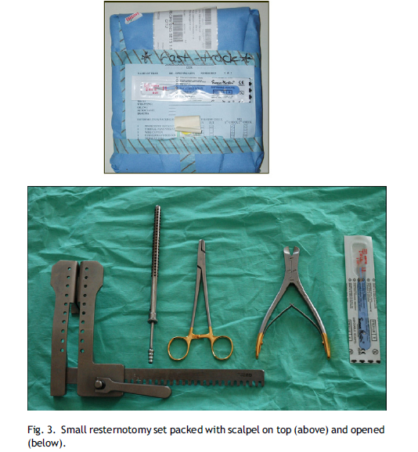

Slide 32
Preparation for emergency resternotomy
Cardiac arrests in the ICU are often promptly attended by more staff members than needed simply to manage basic life support, defibrillation, airway, and decision making.
Two to three staff members should put on a gown and gloves as soon as a cardiac arrest is called, and prepare the emergency resternotomy set , because 20–50% of cardiac arrests after cardiac surgery result in emergency resternotomy
Hand washing is not necessary prior to closed-sleeve donning of gloves

Slide 33
Personnel performing emergency resternotomy
Emergency resternotomy may be required in 0.8-2.7% of all patients undergoing cardiac surgery .
This ensures better assistance for the surgeon and, in the unlikely situation that resternotomy is required and a surgeon is not immediately available, resternotomy by another member staff may be life saving.

Slide 34
Method of internal cardiac massage
This is potentially dangerous and personnel who may be required to perform this must have had prior training to do this safely.
Risks to the patient include avulsion of a bypass graft, with the left internal mammary artery being at particular risk.
Before attempting internal massage, inspect the heart to locate the internal mammary and any other grafts, carefully removing any blood clots.

Slide 35
Method of internal cardiac massage
Pass the right hand over the apex of the heart (minimising the likelihood of avulsing any grafts, as grafts are rarely placed near the apex).
The right hand is then further advanced round the apex to the back of the heart, palm up and hand flat. The left hand is then placed flat on to the anterior surface of the heart and the two hands squeezed together.

Slide 36
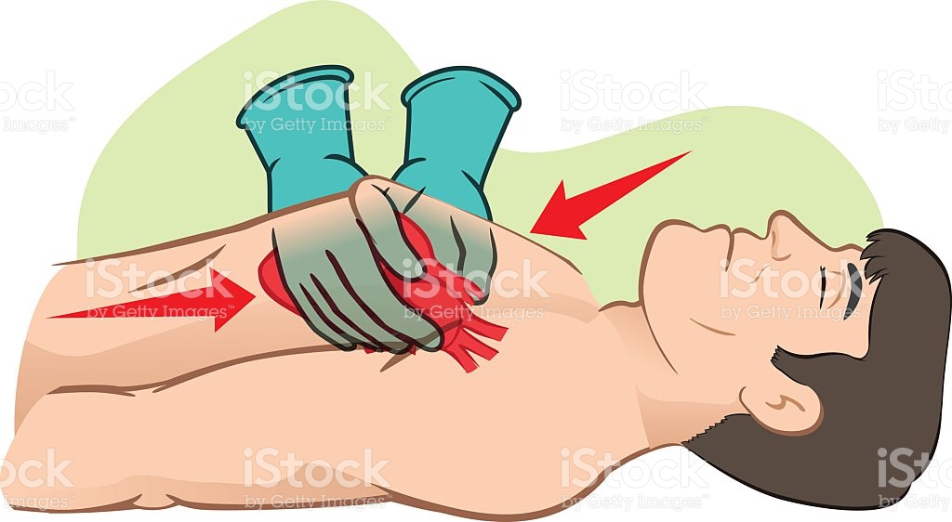

Slide 37
Method of internal cardiac massage
If there is a mitral valve replacement or repair, care should be taken not to lift the apex by the right hand, as this can cause a posterior ventricular rupture. Squeeze your hands together at a rate of 100 per min and look at the arterial trace to verify adequate internal massage. You should try to obtain a systolic impulse of more than 60 mmHg for optimal cerebral perfusion.

Slide 38
How long after cardiac surgery is emergency resternotomy no longer indicated?
Emergency resternotomy should form an integral part of the cardiac arrest protocol up to the 10th postoperative day
Beyond the 10th postoperative day, a senior clinician should decide whether emergency resternotomy should still be performed.
Emergency resternotomy for internal cardiac massage should still be considered in preference to prolonged external cardiac massage even if a surgically reversible cause for the arrest is not suspected.

Slide 39
Should patients receive additional antibiotics after emergency resternotomy?
It is common practice to perform an antiseptic washout after emergency resternotomy and to give additional intravenous antibiotics.

Slide 40
Special considerations
There are many special considerations within cardiac surgery related to the specific operative procedures. The cases below serve as examples and every clinician should consider whether the patient that they are returning to the ICU may present a particular challenge should cardiac arrest occur, and if so, this should be clearly documented and discussed with the ICU staff
Transplant patients
Pediatric patients
‘Open chest’ patients
Patients with a cardiac assist device
Patients undergoing non-sternotomy cardiac surgery

Slide 41


THANK YOU

